Slide 1

Vietnam Coffee Coordinating Board Introduction, Updates and Plans
Mr. Nguyen Do Anh Tuan
General Director - Institute of Policy and Strategy for agriculture and rural development

Slide 2
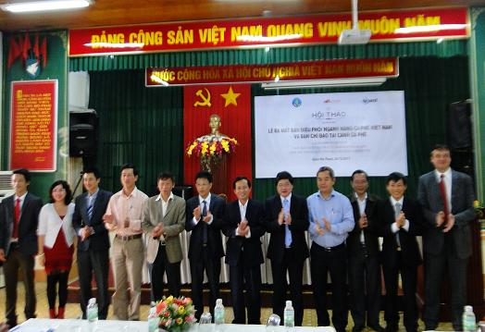
Vietnam Coffee Coordinating Board
Established in July, 2013 by MARD
Mandates
Research, recommend policies, strategies and planning.
Support in implementing policies, strategies and development programs.
Provide advice to coordinate activities and resources
Provide and share information; trade and PPP promotion; capacity enhancement
Participate in International Coffee Organization
VCCB’s opening ceremony in 12/2013

Slide 3
Structure
Private Sector
VICOFA
2 domestic enterprises
(Intimex, Thang Loi)
2 foreign enterprises
(IDH, ACOM)
1 Daklak farmer
1 LamDong farmers
Coordination Board
Chairman
(Vice Minister of MARD)
Co Vice Chairman
(Crop Department, IPSARD)
Public Sector
Processing Department
Planning Department
Int’l Cooperation Department
Daklak PPC representative
LamDong PPC representative
Office
Crop Department , IPSARD, Experts
Production
Sub-committee
Crop Dept
Nestle
Processing & Trade Sub-committee
Processing Dept
Vinacafe
Policy and Sustainability Sub-committee
IPSARD
IDH

Slide 4
Working mechanism
Office based in Croping Department, VCCB’s account opened.
Regular budget: Department, Institute and contribution of members and donors.
Principles
Democracy, collective discussion
Each member: 1 vote
Decision made based on > 50% vote
VCCB meets 2 times/year:
Bi-annual/ annual report
Bi-annual/ annual planning approval
Before the meeting, the members, sub-committees meet with relevant stakeholders to discuss
In special case, VCCB and Sub-committees may call for meetings.

Slide 5
Updates on VCCB activities
Consolidate the structure
Open account and start to receive voluntary contribution
Organize opening ceremony and 2 meetings 2014
Approve working mechanism and plan 2014/2015
Vision
Organization
Minister approved the program
Assigned to support Minister in implementation guidance;
Participate in petition for removing VAT for enterprises
Policy
Comment on Coffee Rejuvenation Program approved
Comment on draft supporting policy for coffee rejuvenation
Guide Dak Lak, Lam Dong, Dak Nong to develop the rejuvenation action plan
Participate in reviewing current rejuvenation models to be used for VnSAT and action plan
Promote rejuvenation program

Slide 6
Update on VCCB activities 2014
Quality improvement
Guide the development of national sustainable curriculum
Trade promotion
Organize Coffee Outlook& Dialogue Forum 2014
Participate in ICO
Connect and sustain communication with ICO
Coordinate the use of resources
Comment on VnSAT project to support coffee
Cooperate with support from SCP/IDH

Slide 7
Production Sub-Committee
Organization
Consolidate structure, merge the coffee PPP group
Private member contributes
Organize 2 meetings
Duties as plan of 2014-2015
Comment on policies relating to production:
Draft rejuvenation support policy
Participate in approved Rejuvenation Program
Support to promote rejuvenation:
Participate in rejuvenation model review
Participate in drafting seedling production plan sent to provinces for comments
Guide and cooperate with Dak Lak, Lam Dong and Dak Nong to develop rejuvenation action plan
Update robusta rejuvenation process; heading to develop grafting process
Effective water management for coffee production
Research, propose water saving measures
Improve coffee quality
Participate in developing national sustainable curriculum
Others:
Continute with dessemination of GAP (75 demo plots, 3600 farmers)
Promote PPP cooperatives

Slide 8
Policy & Sustainability Sub-committee
Organization
Consolidate structure and working regulation
Propose meeting and decision making protocol of VCCB
Propose reporting and planning template for VCCB
Meet 3 times
Duties as plan of 2014-2015
Comments, feedbacks on policies relating to coffee sector:
Drat support rejuvenation policy, …
VAT removing for enterprises
Develop Sustainable coffee program and implementation plan:
Program approved
Prioritized policies proposed to implement the program
Market information analysis and dessemination
Participate in policy/development program monitoring and assessment
Others:
Support Production Sub-committee in the development and dissemination of National Sustainable Curriculum and rejuvenation model review
Support VCCB Office to connect with VnSAT and ICO

Slide 9
Processing and Trade Sub-committee
Organization
Consolidate structure
Duties as plan of 2014-2015
(not yet official meeting and implementation)
Comments on policies relating to processing and trade
Improve the quality of coffee
Guide the finalization of ECVN for coffee bean and implementation roadmap
Guide the development of processed coffee standards
Expand the application of certified coffee standards
Research, propose solutions to improve post-harvest stage
3. Promote sustainable coffee trade
Research, propose policy for coffee branding
Develop domestic and abroad markets, trade promotion

Slide 10
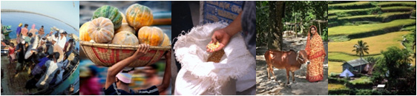
Vision of VCCB
VCCB and international experiences?
Ghana Cocoa CB
VFA
India Coffee CB
Sri Lanka Tea CB
Public
VCCB
Private
Marketing/service provision
Formulate/ coordinate policy implementation
Export cooperatives in Brazil
Policy consultation
Coffee growers association in Colombia
Kiwi Marketing Board in NZL
KTDA

Slide 11
Pathway for development of VCCB
Public
Present
Short term (2014-15)
Enable participation
Medium term (2015-20)
Promote PPP activities
Long term (after 2020)
Empower the producers
VCCB
VCCB
VCCB
VCCB
Marketing/services
Role:
Policy consultation
Role:
Coordinate public resources
Consult policy
Form services (i) S&T (ii) Credit (iii) Market
Activities:
Run the office effectively
Run the activities of sub-committees
Form services
Role:
Coordinate private & public resources
Review and consult policies
Develop services
Develop sector organization (farmers participate in market regulation through companies and cooperatives)
Participants:
MARD, MOT, MOF
Farmer organization
Companies
Finance
Government budget
Service fee (public)
Role:
Coordinate resources
Propose policies
Make regulation and licensing
Complete services
Organize farmers to regulate markets through companies and cooperatives
Participants:
Governmental representatives
Farmers organizations
Enterprises representative
Finance
Service fees
Trade and production tax
Private

Slide 12
General assessments
Advantages
Challenges
Consolidate the organization of VCCB and sub-committees (member, working mechanism, vision, account…)
Participate in commenting, and formulating some policies, strategies (sustainable development program, rejuvenation support policy, VAT removing,…)
Attract the participation of stakeholders (PPP merge in Production Sub, more members of P&S sub-committee…)
Widely dissemination of VCCB activities
Lack of resources (office personnel, regular budget,…)
Not yet familiar with new working style (meetings, voting,…)
The Processing&Trade sub is still weak
Weak participation of farmer representatives
Office is still weak in coordination and promoting activities
Not fully informed and consulted by Ministries, departments on policies relating to coffee sector

Slide 13
Some recommendations
1. Improving the activities of the Office
Fund mobilization:
+ MARD
+ Contribution from members
+ VNSat Project
Recruit 01 full-time staff
2. Improve the activities of VCCB
Enhancing the representative capacity of members
Complete the meeting and decision making protocol
Complete the financial regulation (contribution, expenditure…)
Request Ministries, MARD’s departments to provide information and consult VCCB during policy making, commenting and recommendation.
3. Improve the capacity and organization of Coffee Farmer Association
Daklak accelerates the establishment of Daklak Coffee Farmer Association
Daklak and Lam Dong cooperate with VCCB in mobilizing resources to enhancing capacities and activities of coffee farmers association: SCP, VnSAT
4. Enhancing the activities of Processing &Trade sub-committee

Slide 14
THANK YOU

