Slide 1
Digitizing Agriculture Farm Force Digital Solution
July, 2016

Slide 2
how Digitizing Agriculture can lead to Financial Inclusion
AGRI EFFICIENCY
FINANCIAL INCLUSION
Quality & Traceability
Certification requirements
Maintaining and improving yields
Information and Market Access
Extension services and best practices training to farmers
Communicating pricing information to farmers
Forecasting, Management and Sourcing
Being able to forecast for effective inventory planning
Digitizing farmer information – easier KYC, document collection
Bank Accounts for farmers – electronic payments to farmers
Facilitating easier access to credit with better credit terms
Credit products better suited to farmers requirements
TECHNOLOGY SOLUTIONS
ERP Solutions helping to maintain farmer profiles, their productivity, historical records & more
Market information solutions to send weather information, best practices & more to farmers
Traceability Solutions helping to develop traceability from farm to buyer
Bankability Solutions which use farmer data to assign bankability scores to farmers

Slide 3
Reviewing Farmers requirements
Quality & Traceability
Information & Market Access
Forecasting & Others
Access to Finance
Maintaining Certification requirements
Judging quality of output
Forecasting total output
Ensuring Traceability
Ensuring long term relationships with buyers
Getting timely and relevant information about the following
Advisory for specific issues and crop diseases
Training for best practices
Weather information
Input and Output price information and trend (to judge the right time to buy and sell)
Forecasting output
Optimum input usage - Pesticide, Insecticide & Fertilizer
Keeping a track of payments due to them and payments that they need to make
Competitive benchmarking for their productivity
Credit requirements –easy access to credit, information about interest rates and credit despite ownership of land title to be able to get loans
Payment Requirements- Bank Accounts to receive and make payments
Savings requirements
Insurance Requirements

Slide 4
farm force
The Farm Force Server is a cloud based web application, provided on Software as a Service (SaaS) basis using mobile technology to replace existing paper based which helps increase management information, efficiency and transparency, and simplify audits
Simple and easy to use with limited maintenance cost : A onetime setup fee & subscription fee - clients do not need to employ additional IT while FF will cover hosting, software upgrades, 2nd line technical support, backups and redundancy
A commercial set up rolled out since April 2013, tested and deployed , with local language availability around 35 External Client & 80,000 farmers
Client facing offices in Nairobi, Guatemala City and Bangkok
SECO, USAID Funding Guatemala, PIP/COLEACP Service Provider
IFC is piloting Farm Force in Vietnam with Simexco/JDE in its Value chain
Notes:
- It uses mobile technology to replace existing paper based processes and thereby provide traceability to the field level, communicate with farmers, increase management information and transparency, document compliance with any food and sustainability standards (GLOBALG.A.P., FairTrade, Rainforest Alliance, Organic) and simplify audits
-around 35 External Clients – Guatemala, Kenya, Tanzania, Mozambique, Malawi, Ghana, Nigeria, South Africa, Thailand, Vietnam, Myanmar, Guatemala,

Slide 5
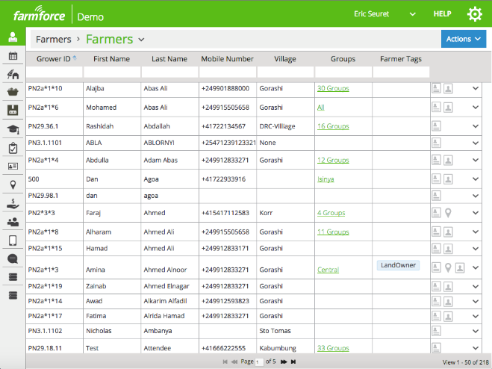
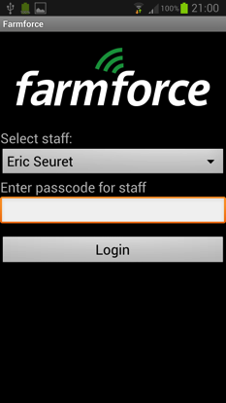
Farmforce - Website and Mobile App
The mobile client is used by field staff who interact with the farmers
s
Notes:
This combination of technology is used to replace paper based processes associated with farmer information management, the growing process, standards certification, harvesting, procurement, traceability and supply chain management. The system includes a number of dashboards to display information about farmers (see below), harvest crops and production targets. These dashboards are used by staff based in the office to manage the scheme in real time.

Slide 6
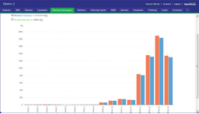
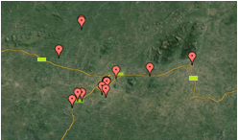
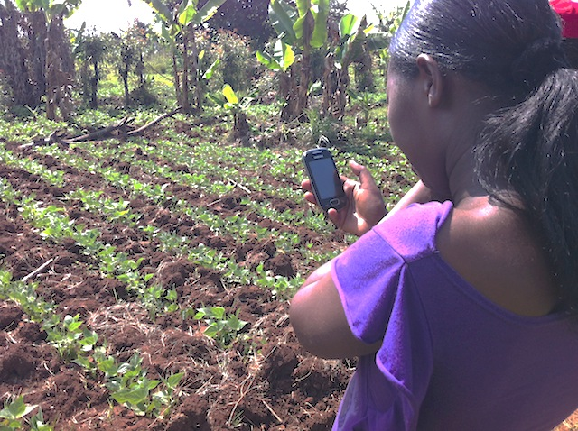
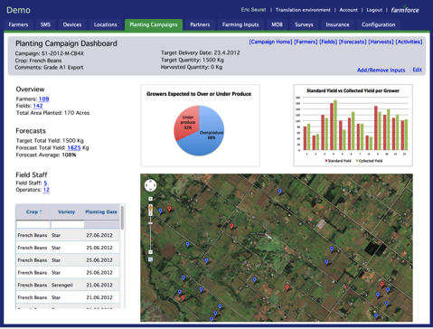
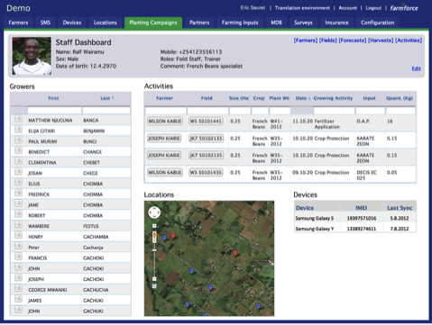
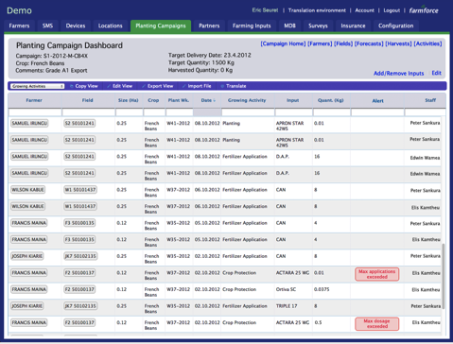
Mobile Entry of: Pesticide Records, Yield Forecast, Crop Scouting, Harvests & More
What Does Digital Management Look Like?
Weekly Production Forecasts across an entire scheme
Geo-Referencing for Security
GlobalG.A.P compliant record management for 1000’s of outgrowers
Field Staff can be monitored and managed via the web.
Internal Control System for Pesticide Usage Rules and Harvest Intervals
Notes:
This combination of technology is used to replace paper based processes associated with farmer information management, the growing process, standards certification, harvesting, procurement, traceability and supply chain management. The system includes a number of dashboards to display information about farmers (see below), harvest crops and production targets. These dashboards are used by staff based in the office to manage the scheme in real time.

Slide 7
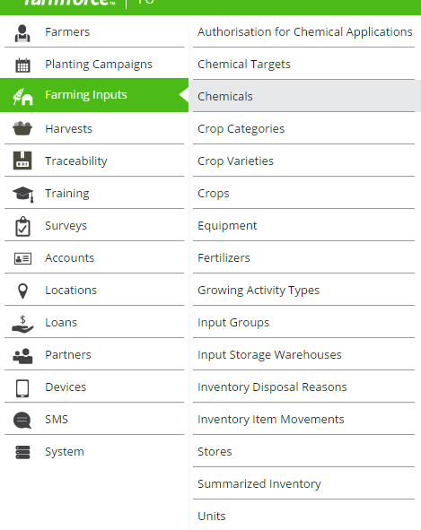
Farming Inputs Menu

Slide 8
Solutions to First Mile Problems – Previous Clients
Yield Forecast Accuracy Doubled
Real-time Management and KPIs for Field Staff
Farmer Level Traceability 10x more accurate
Field Staff Effort Reduced by 30%
Elimination of Ghost Farmers: Previously 40% of Farmers
Results Delivered for Previous Clients

Slide 9
Thank you

