Slide 1
Water Management & Climate Change Achievements 2016
Author: Dr. Dave A. D’haeze
Date: 5 December, 2016
Event: Vietnam Coffee Coordination Board – Annual Meeting
Location: Ho Chi Minh City, Vietnam

Slide 2



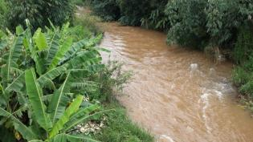
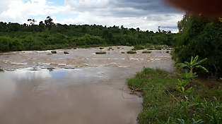
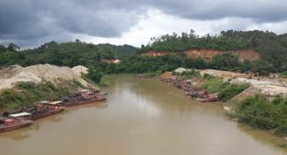
Water Program 2014 – 2017 (conditional 2019)
Vietnam to Produce More Coffee With Less Water -
Towards a Reduction of the Blue Water Footprint
in Coffee Production

Slide 3
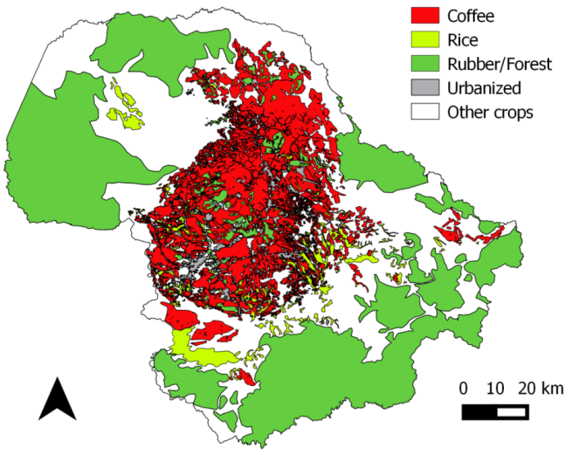
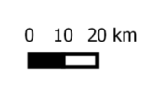

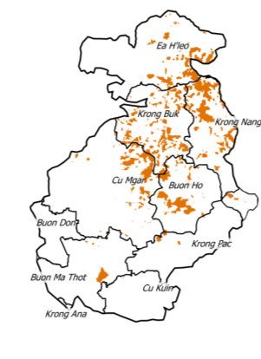
Water Program – Achievements
Geohydrological baseline study on the Dak Lak basalt plateau
No long-term declining water level trends observed
Water level decline during the dry season is responsible for running dry of shallow wells and is correlated with:
the location of the well
the irrigation practices
Excess irrigation water is temporarily trapped in the soil and is not available for use during the dry season
Water scarce hot spots are concentrated in the higher altitudes of the plateau and in the East (Krong Buk, Buon Ho, Krong Nang).

Slide 4
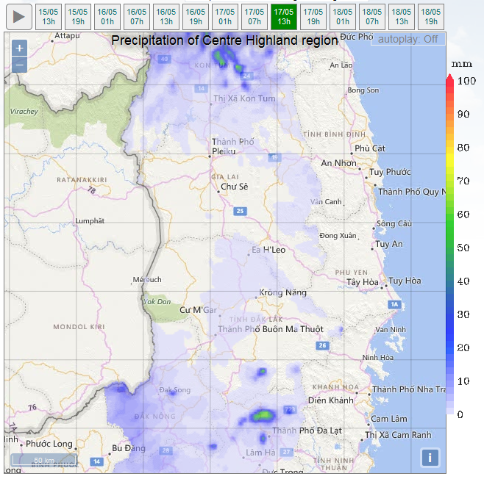
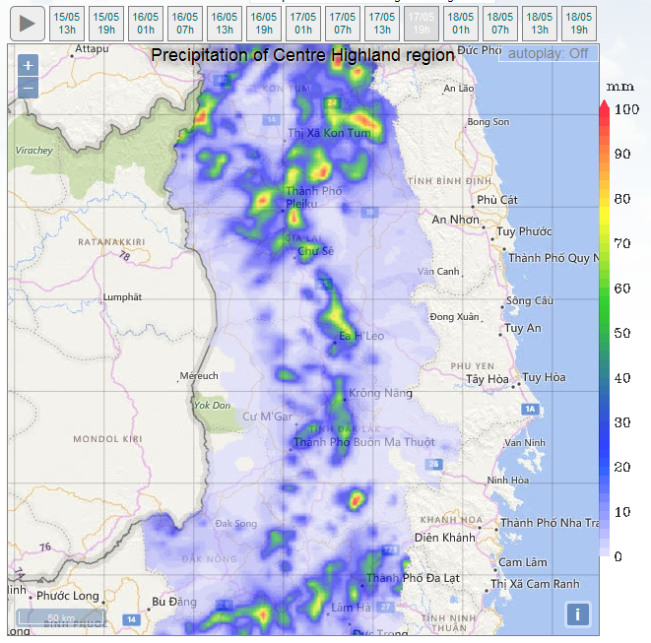
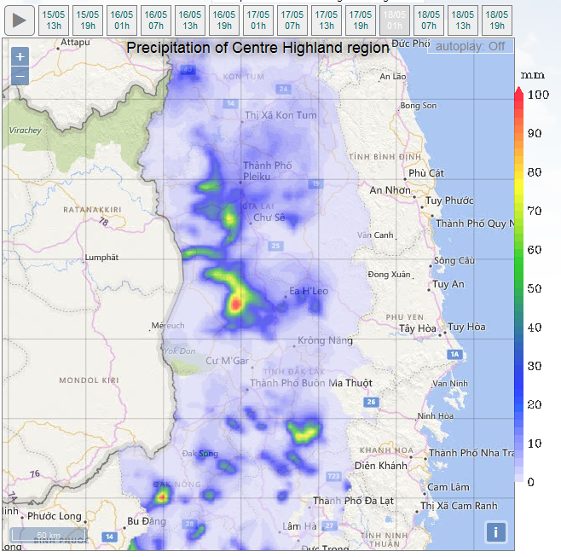
Water Program – Achievements
Short term weather forecasting system in test phase
17 May 2016; 13 h
17 May 2016; 19 h
18 May 2016; 01 h

Slide 5
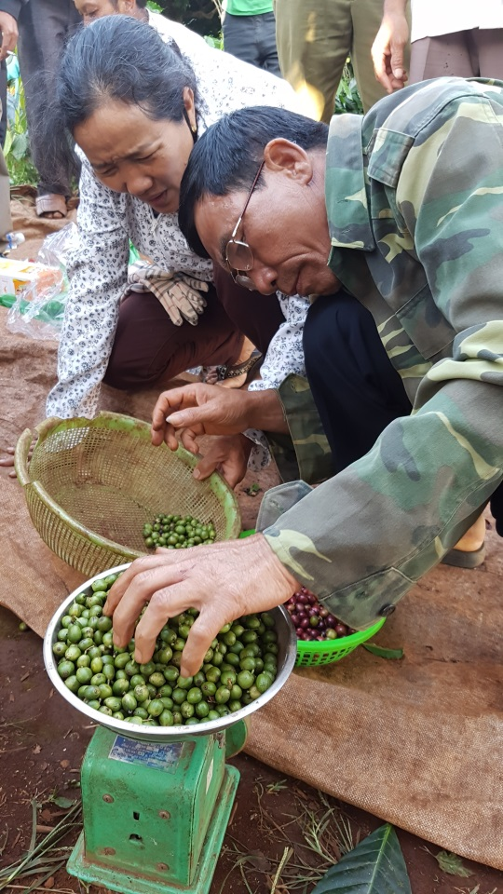
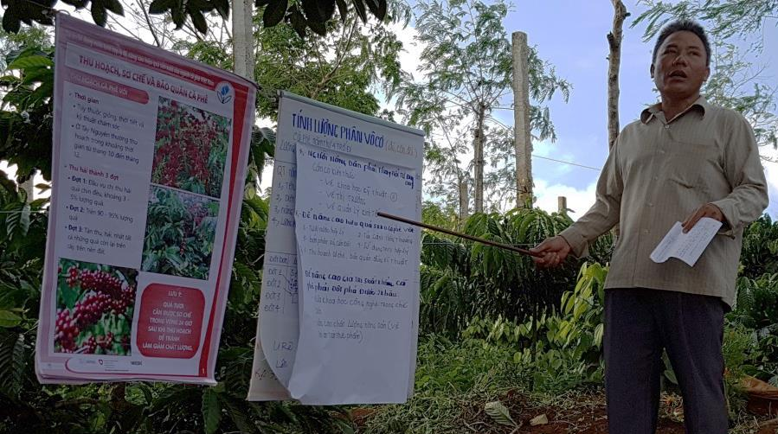
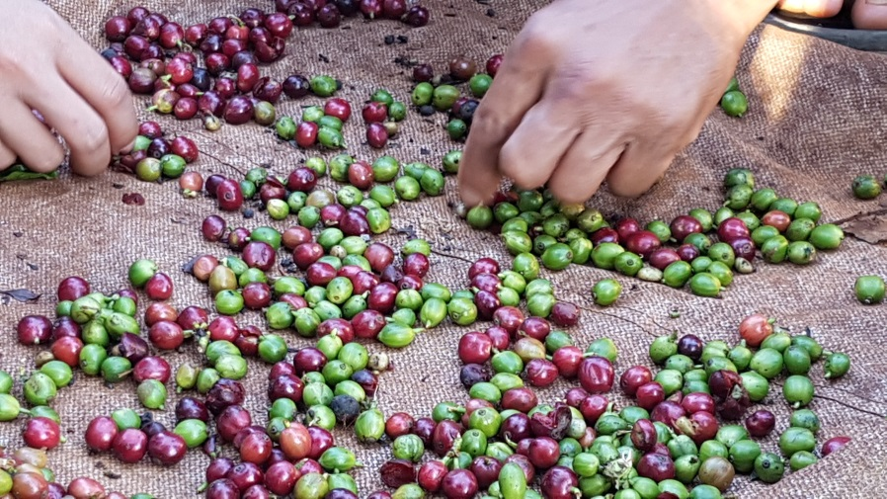
Water Program – Achievements
Goal: 125 trainers and 50,000 farmers trained on GAP – focus on rational water use
Circa 120 trainers trained in 4 provinces on 6 topics
Training contacts 2015 (2 provinces): 30,340; whole year
Training contacts 2016 (4 provinces): 22,500; June 2016

Slide 6
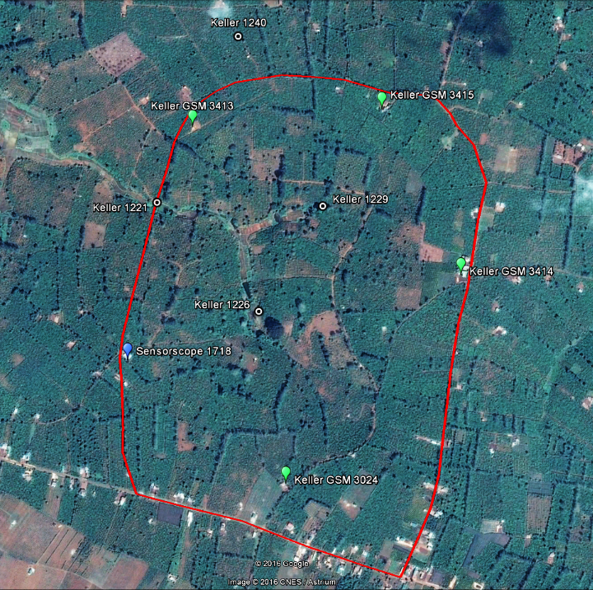
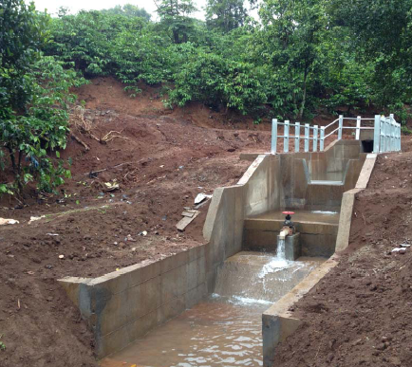
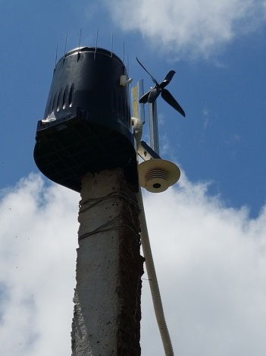
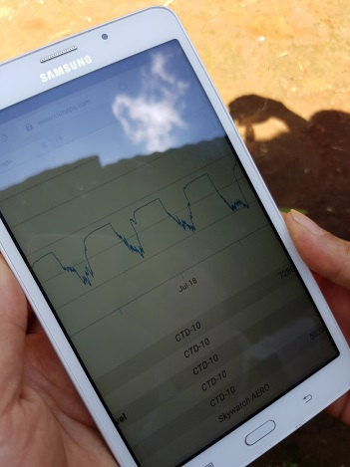
Water Program – Next Steps
Quantify the impact of changing irrigation volumes for coffee, from actual state to best practices by high-resolution monitoring of weather and water variables
Introduce local stakeholders to new, modern water monitoring technology
Assess the possibility to pilot artificial groundwater recharge
Design farm management guidelines based on predicted rainfall

Slide 7






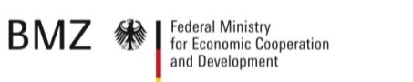








Initiative for Coffee & Climate
Founding members
New partners
Implementing agents Hanns R. Neumann Stiftung /EDE Consulting VN, CABI, (GIZ)
Duration Project phase I: Sept 2010 – Aug 2013
Extension: Sept 2013 – Dec 2014
Suggestion new project phase: 2016 – 2019
Pilot Countries Brazil, Guatemala, Tanzania & Vietnam
Objective Enable coffee farmers to effectively respond to climate change

Slide 8
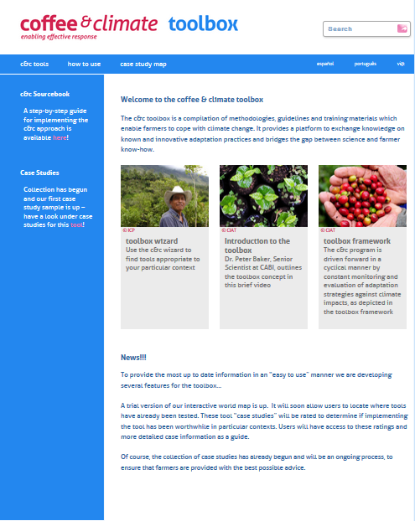
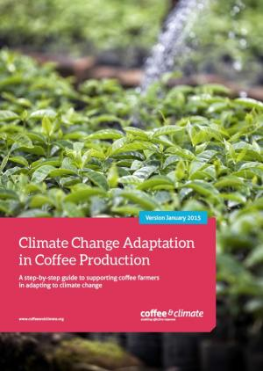
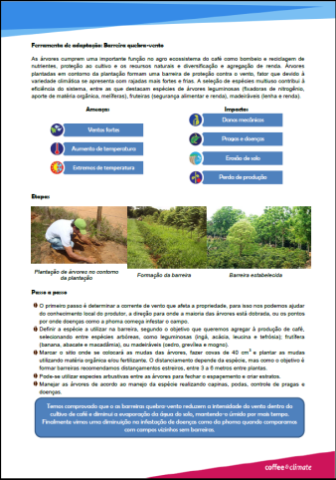
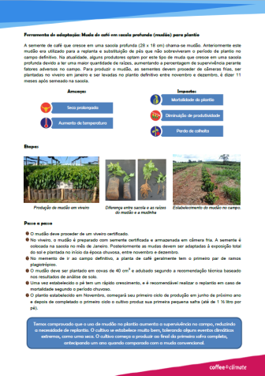
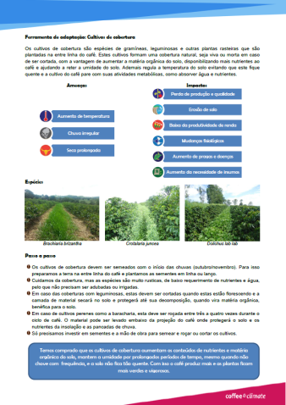
Initiative for Coffee & Climate – Achievements
Scientific research
Historic climate trend study for the Central Highlands + policy brief
Water and Carbon footprint for different coffee farm management systems
C&C Toolbox

Slide 9
Initiative for Coffee & Climate – Achievements
Farmer Training
Training of Trainers for ext. officers, agronomists private and public sector & lead farmers
Farmer Field School for 800 farmers in Dak Lak (rational irrigation and fertilizer use, composting & crop diversification); adoption between 75 and 93%
Policy Advocacy
Establishment 5 info points (NAEC, PAEC, Tay Nguyen Univ., 1 distr. Agr. Dept & 1 coop)
C&C approach applied in Tay Nguyen University for Master students
Vietnam coffee sector included in INDC and presented at COP 21 (December 2015)
Mentioned adaptation & mitigation
(Yes-Yes)
Eight countries mentioned the
coffee sector in their INDC submissions (see countries in bold lettering on left), representing 34% of coffee production.

Slide 10
Initiative for Coffee & Climate – Next Steps
Develop a National Coffee & Climate Sector Wide Strategy
Bottom up and multi-stakeholder approach
Setting the scene (recent research findings, current climate change programs,…)
Prioritization of the challenges
Identification of causes and intervention needs
Development of a Sector Program and Implementation Roadmap

Slide 11
Thank You

Slide 12
www.hrnstiftung.org dave.dhaeze@ede-consulting.com

