Slide 1

GCP Annual Plan 2017 - Vietnam
Trần Quỳnh Chi
IDH country manager

Slide 2

Water management
- Evaluate efficiency, scalability of water harvesting - saving
- Study artificial ground water recharge
- Assess water monitoring system & recommend
- Surface water
- Water harvesting
- Water saving
- PPP irrigation
- Responsible water use
- Proper water management system
2020 action plan
GCP 2017

Slide 3

Sustainable coffee production
National Sustainability Curriculum
2017-2020
- NSC assurance system and recommendations for farmers
- NSC communication
2017-2018
PPP Pilots of large-scale consolidated farms applied NSC
2017
NSC revised towards climate change adaptation
85% coffee comply with NSC/
baseline common code

Slide 4
Study changes made to legislation to control agrochemical trade and use
Pilot in 1 key coffee province: stronger enforcement of agrochemical suppliers.
- Follows requirements of importers
- PPP control of agrochemical trade
2017 2017-2018 2020
VCCB
4C
ISEAL
Review situation of pesticide use and management”
Baseline & design of system
System piloted
Analyse results from farmers interview
Pesticide use and its impacts on environment and human health
Training & awareness
List of pesticides allowed in coffee

Slide 5

Sector Governance
Associations
Farmer organizations
Product consolidation
Farmers
Ministries
Effective National Platform - VCCB
Business

Slide 6

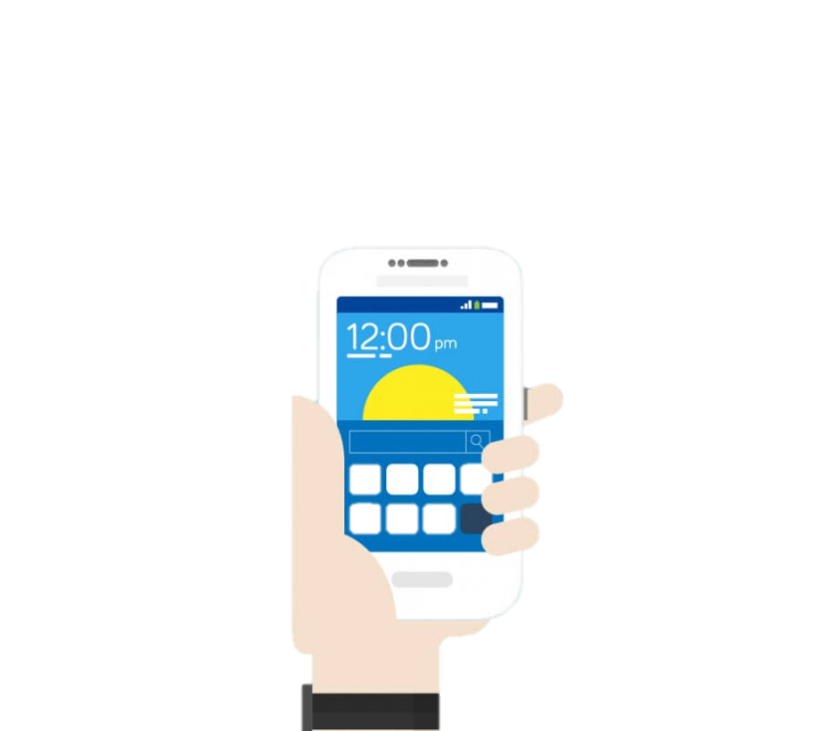
Open source – Collaboration with Grow Asia
One stop shop for Farmers
Green Coffee
FFP
Agri-media
IFC information
system
20*
System potentially connected
4 services
Information alerts
Knowledge
Market place
Financial services
Single, easy to use interface
Powered by MNOs
Local partners in each country

Slide 7

Contact:
Tran Quynh Chi
Country Manager, IDH Vietnam
chitran@idhsustainabletrade.com

