Slide 1
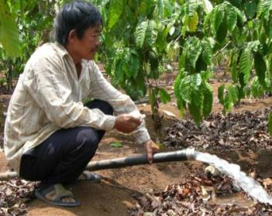
Vietnam to Produce More Coffee With Less Water
Towards a Reduction of the
Blue Water Footprint
in Coffee Production
Hydrogeological Study on the Dak Lak Basaltic Plateau Towards modern watershed monitoring & management
Authors: Dr. Ellen Milnes
Dr. Francois Negro
Msc. Stephan Studer
Dr. Dave D‘haeze
Prof. Pierre Perrochet
Date: July 19th, 2016
Venue: Buon Ma Thuot, Dak Lak, Vietnam

Slide 2
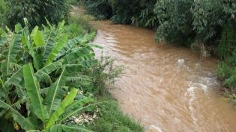
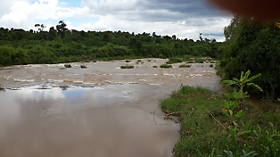
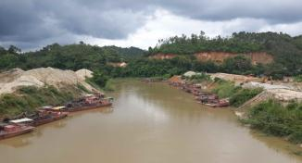
Overview
Rationale
Objectives
Potential Impact
Results
Conclusions
Recommendations
Water Monitoring Strategy
Next steps

Slide 3
Rationale
Global coffee demand is increasing while productivity in Vietnam may potentially decline, despite
Rejuvenation programs & new high yielding varieties
Production in Vietnam is at risk
Looming water scarcity & climate change
Irrigation water is a pre-condition to make coffee production economically viable
Current average 2.3 Mt/ha; potential 4 Mt/ha
Current irrigation practices are unsustainable and endanger
Coffee productivity
Household water supply
Hydro-power generation
Production of other water demanding (food) crops
Current irrigation practices for coffee can be reduced by at least 30%
Government recognition importance of water for coffee (cf. Nestle-SDC policy brief, 2013)
Vietnamese request for larger scale interventions
Current momentum should not be missed

Slide 4
Objectives
Overall Objective
Equitable and sufficient water availability for all water users in the Central Highlands
Pivotal water savings through improved irrigation management in the coffee sector
Improved people’s livelihoods in socio-economic terms and environmental protection
Specific Objective 1 Water resources management is improved
Water supply and demand inventoried in Dak Lak province
Impact of coffee production on water resources assessed
Water scarce hotspots identified
Water Action Plans formulated, implemented and monitored for 2 pilot micro-catchments
Specific Objective 2 A weather early warning system supports optimization of coffee farm management
A weather early warning system designed, tested and implemented for one Central Highland’s province in order to support optimization of farm management.

Slide 5
Objectives
Specific Objective 3 Scaling up through farmer trainings
50,000 small-scale and poorer farmers deprived of information, in the 5 main coffee producing provinces produce coffee in an economically and particularly water efficient manner
Access to improved technological support with regard to water management and GAP for Robusta production which leads to important water savings in agriculture
Specific Objective 4 Policy advocacy
The project is a concrete model featuring the subject of water efficiency in international policy debates
Relevant policy makers have been sensitized through the project’s results
.
Ha Noi
Kon Tum
Gia Lai
Dak Lak
Dak Nong
Lam Dong
.
Ho Chi Minh

Slide 6
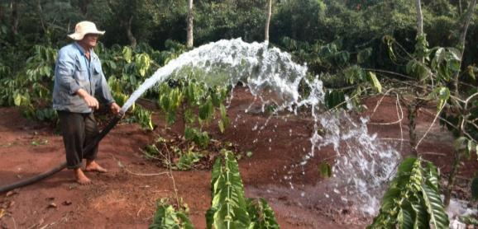
Potential Impact
Water for annual household consumption available for 25 million water users (28% National population)
Assume 120 liter per day per capita for household use
500,000 (100%) coffee growers reduce irrigation
1,000 (conventional irrigation practice) → 400 liter/tree/round (-60%)
Absolute water savings of 1 billion m³
If all coffee farmers adopt Best Irrigation Practices

Slide 7
Results: Two-Step Approach
Provincial scale
What is the large scale potential water availability in Dak Lak province?
Are there potential water scarce “hot-spots” for irrigated coffee production?
Basaltic plateau scale
Has any long-term groundwater decline been observed?
Does excessive irrigation water replenish the groundwater within the current dry season?
Where are high risk areas prone to drying up of wells and what are the reasons?
Best irrigation practices for coffee - a solution to avoid seasonal drying up of shallow wells?

Slide 8
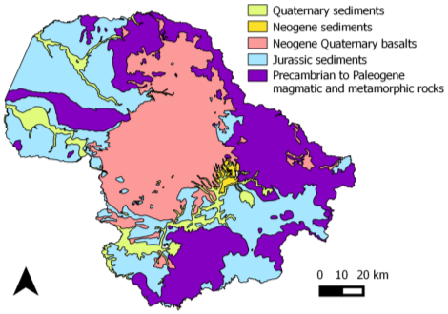
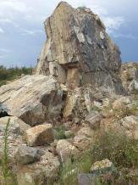
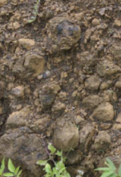
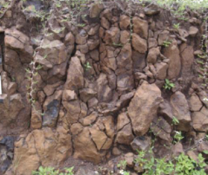
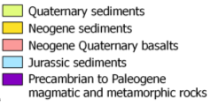
Results: Provincial Scale -Aquifer types
From geology to hydrogeology
Identification of rock types in terms of hydraulic properties and spatial distribution
5 geological units in Dak Lak
Basaltic plateau is the largest continuous aquifer system
Basaltic plateau
Granite
Weathered basalt
Fractured weathered basalt

Slide 9
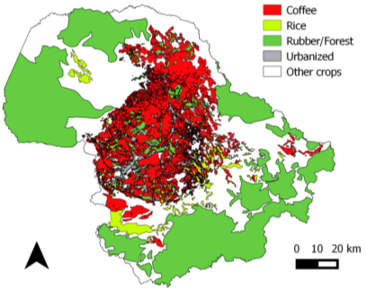
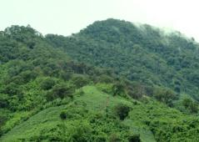
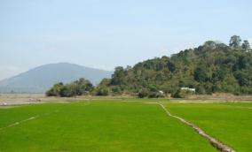
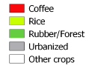
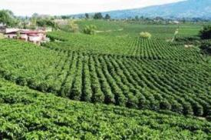
Results: Provincial Scale - Land Use Mapping
Land Use
18.5% of Dak Lak is covered with coffee
86% of coffee on the basaltic plateau
Strong correlation between land use and geology
Coffee plantations are concentrated on the basaltic plateau
Forest
Paddy rice
Robusta coffee

Slide 10
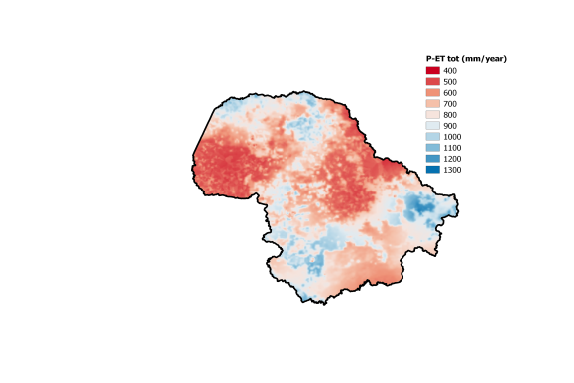
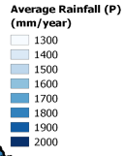
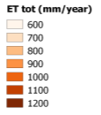
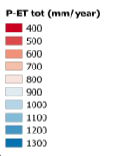
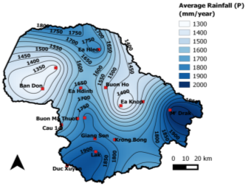
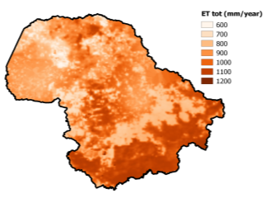
Results: Provincial Scale - Water balance
Annual Average Water Balance (P – ET )
Provincial average annual rainfall: 1,300 – 2,000 mm/year
Lowest annual rainfall: lowest altitudes (NW Dak Lak) & eastern basaltic plateau.
Highest evapotranspiration: forest areas (south-east) & coffee areas (central basaltic plateau)
3 low potential water-availability areas:
Eastern half basaltic plateau: highly evaporative coffee plantations & lower rainfall
North-west: forests
South-east: forests
`
2
1
3

Slide 11
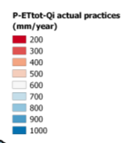
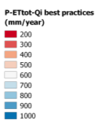
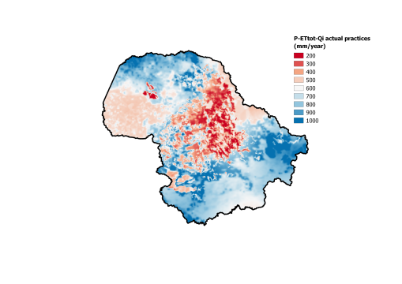
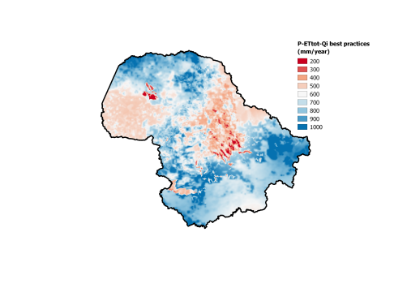
Results: Provincial Scale - Water Scarce Hot Spots
Potential Annual Average Water Deficit
Deducting dry-season water requirements (irrigation) from the annual water availability map
Highest risk areas:
irrigated coffee on the eastern half of the basaltic plateau
paddy rice
forest areas in the northwest
Current coffee irrigation practices may pose a higher risk compared to best practices:
in the dry season (seasonal issue)
on the basaltic plateau
1
1

Slide 12
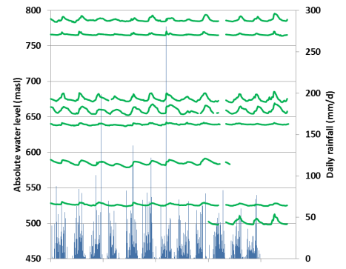
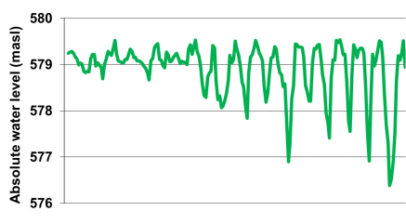
Results: Basaltic Plateau Scale - Water level analysis
Long-term groundwater level analysis
Stable groundwater body
No historic large-scale declining water level trends
Groundwater recharge in rainy season replenishes water extractions in dry season
No long-term historic
groundwater level decline
LK70
LK71
LK29
LK30
C4o
CB1-II
LK49
LK69
2003
2001
2014
E.g. borehole C4a (border Krong Pach and Krong Buk); increased water level fluctuation since 2003, no water level decline
1993
2010

Slide 13
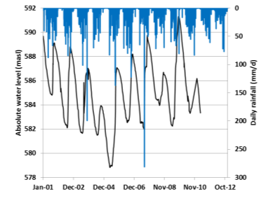
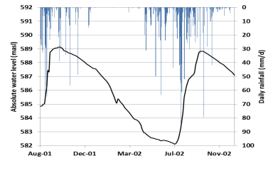
Results: Basaltic Plateau Scale - Water level analysis
Seasonal groundwater level analysis
Seasonal groundwater recharge takes place 60-100 days after onset of rainy season (in areas with unsaturated zone > 15m)
Water level fluctuation amplitudes are correlated by order of importance with:
the thickness of the unsaturated zone (related to the relative topographical position)
the distance to the closest discharge area (spring, stream, lake, river)
Monitoring borehole CB4-II: long term
Monitoring borehole CB4-II: close up
Onset rainy season
Time lag (days)
Onset recharge

Slide 14
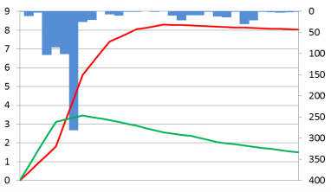
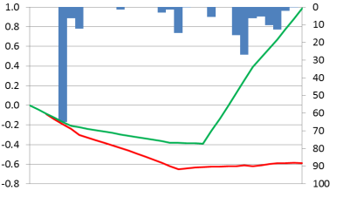
Results: Basaltic Plateau Scale - Water level analysis
Event groundwater level analysis
Extreme rain event within the rainy season (August 2007); 600 mm of rainfall in 6 days
Wet soil
→ Deep percolation reaches groundwater within 10 days (depending on soil thickness and hydraulic properties)
Rainfall event end dry season (April 2007); 83 mm of rainfall in 3 days, similar to an irrigation event
Dry soil
→ Deep percolation does not reach groundwater within the dry season, as groundwater levels continue to decline (until early May)
Excess water from over-irrigation temporary retained in the unsaturated soil column
Rainy season; wet soil
LK29 (15m)
C8b (4m)
30 July
01 September
Water level change since event start (m)
Dry season; dry soil
Similar to irrigation event
C8b (4m)
LK29 (15m)
12 April
15 May

Slide 15
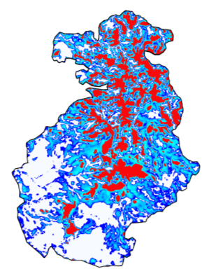
Results: Basaltic Plateau Scale - Areas at risk of running dry
3D numerical model to map the spatial distribution of the area at risk of running dry from a hydrodynamic perspective
Unsaturated zone exceeding the shallow aquifer thickness of 30 meters
Unsaturated soil thickness
Hydraulic head distribution
Calibration
Unsaturated zone exceeding shallow aquifer thickness
Lake
Shallow aquifer water bearing
Computed heads (masl)
Shallow aquifer pressurized; artesian conditions
Measured average water level (masl)
Pressurised area (artesian)

Slide 16
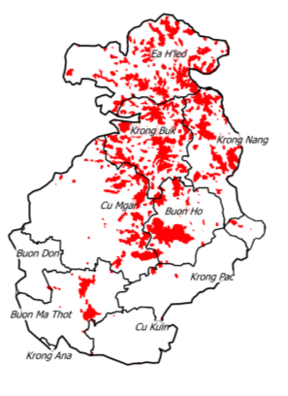
Results: Basaltic Plateau Scale - Dry area risk maps
Areas with high topography (relative) & far from local discharge areas
Water table depth > 30 m → shallow aquifer dry
Unsaturated soil thickness
2. Unsaturated soil thickness >30m
Unsaturated zone exceeding shallow aquifer thickness
Shallow aquifer water bearing
Shallow aquifer pressurized; artesian conditions

Slide 17
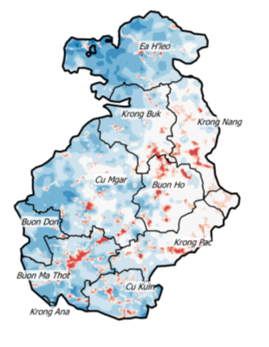
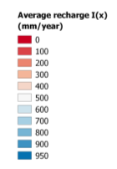
Results: Basaltic Plateau Scale - Groundwater recharge
Spatial groundwater recharge distribution
Surface water runoff and base flow were obtained from hydrograph separation (for Krong Buk catchment and extrapolated to the basalt plateau)
Groundwater recharge =
Rainfall – Evapotranspiration – Surface
Runoff
Groundwater recharge in the West almost double than in the East (because of rainfall):
West : 500 - 900 mm/year
East: 300 - 500 mm/year
Average recharge
(mm/year)

Slide 18
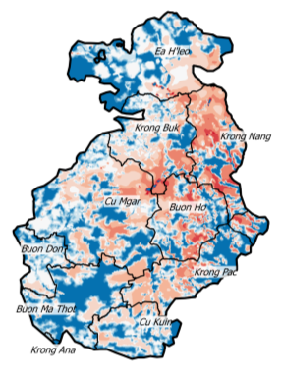
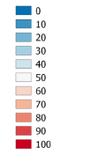
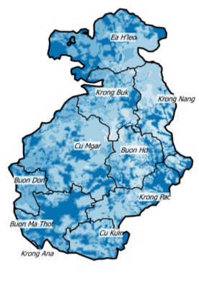
Results: Basaltic Plateau Scale -
Water scarcity
Irrigation extractions vs. groundwater recharge (Q/I)
Irrigation extractions (Q) take place during the dry season and groundwater recharge (I) mainly during the rainy season
Ratio (Q/I) reveals the spatial distribution of water scarcity, accounting for seasonal effects
→ Current irrigation practices
Groundwater extraction (Q) is 50 – 100% of annual renewable groundwater recharge (I) in many areas
→ Best irrigation practices
Groundwater extraction (Q) is mostly 20 – 40% of annual renewable groundwater recharge (I)
Current Irrigation Practice
Irrigation vs. groundwater recharge (%)
Best Irrigation Practice

Slide 19
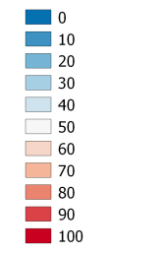
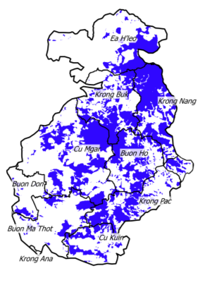
Results: Basaltic Plateau Scale - Water scarcity maps
Areas with low water availability
Irrigation extraction > 50% annual renewable groundwater recharge
Ratio irrigation vs. recharge (%)
1. Ratio irrigation vs. recharge >50%

Slide 20
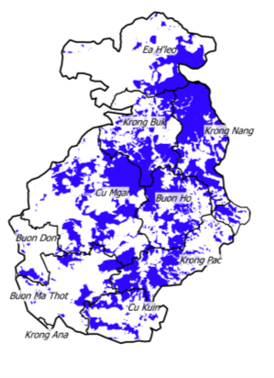
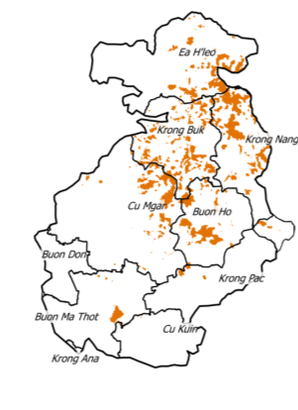
Results: Basaltic Plateau Scale - Water scarce hot spots
Water scarce hotspots combined effect of low water availability and risk of running dry
Map overlay of:
Irrigation extraction > 50% annual renewable groundwater recharge
Areas with high topography (relative) & far from local discharge area
Unsaturated soil thickness > 30 m
Water scarce hot spots:
Combination 1 * 2
1. Ratio irrigation vs. recharge >50%
2. Unsaturated soil thickness >30m
x
=

Slide 21
Conclusions
Provincial scale
Strong correlation between land use and geology: 86% of provincial coffee production on basaltic plateau
Water scarce hot spots are mainly in irrigated coffee areas on the eastern half of the basaltic plateau
Current coffee irrigation practices lead to higher water scarcity as compared to recommended best practices in the dry season
Basaltic plateau scale
No long-term declining water level trends observed
Water level decline during the dry season is responsible for running dry of shallow wells and is correlated with:
the location of the well
the irrigation practices
Excess irrigation water is temporarily trapped in the soil and is not available for use during the dry season
Water scarce hot spots are concentrated in the higher altitudes of the plateau and in the East (Krong Buk, Buon Ho, Krong Nang).

Slide 22
Recommendations
Changing the irrigation practices from conventional to best practices to reduce the risk of wells drying up, with special focus on water scarce hot spots where the impact is biggest
Monitoring of water-scarce micro-catchments to assess the impact of the irrigation practices on the water resources
Up-scaling of method to map water scarce hot spots could be applied to other basaltic plateaus in the Central Highlands with similar characteristics

Slide 23
Water Monitoring Strategy -
Objectives
Quantify the impact of changing irrigation volumes for coffee, from actual state to best practices by high-resolution monitoring of
Groundwater levels,
Catchment run-off,
Soil moisture,
Rainfall; and
Evapotranspiration.
Introduce local stakeholders to new, modern water monitoring technology
Identify and actively involve local stakeholders in
Data collection,
Data analysis,
Data interpretation; and
Policy formulation.

Slide 24
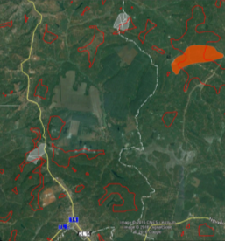
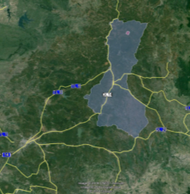
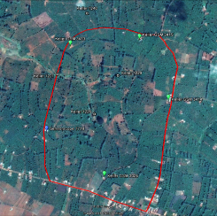
Water Monitoring Strategy -
Catchment Selection
Criteria
Water-scarce hot spots, as obtained from the base-line study
Within the two approved districts (Kronk Buk and Krong Nang)
Accessibility
Willingness of farmers
Areas, where farmer training is planned
No state farms (as they usually have access to surface water tapped from reservoirs)
Field Survey
Surveying 19 shallow wells, 1 borehole and 2 springs
Size of micro-catchment: 1 km²
2
1
3

Slide 25
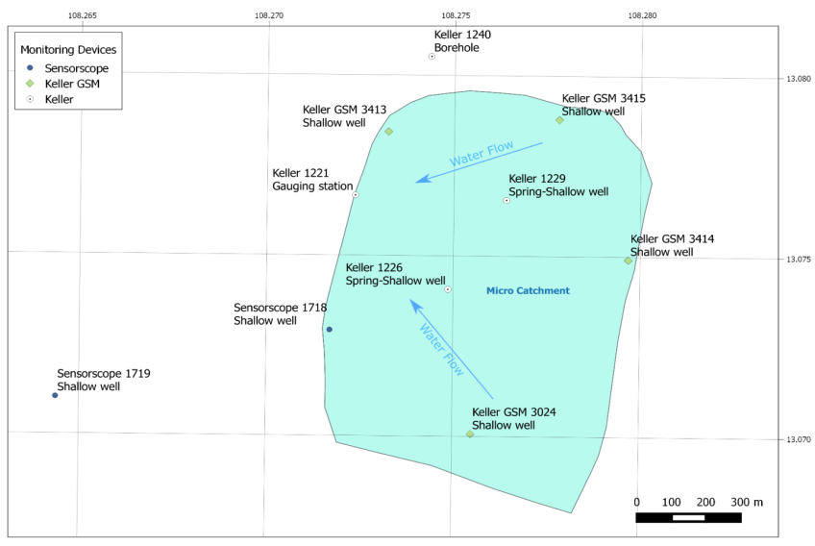
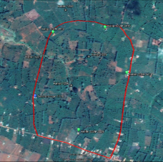
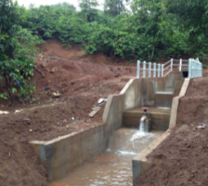
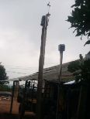
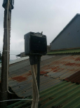
Water Monitoring Strategy -
Monitoring Setup
Quantifying

Slide 26
Next steps
Next steps
Identify local partners to actively conduct water monitoring, analysis and reporting
Identify a PhD student to join the project and elaborate further on the initial findings of CHYN University
Sketch the current water management procedures in the Central Highlands/Vietnam and identify redundancies/gaps
Who is responsible for what?
Who collects which data?
Who consolidates data?
Who reports to whom?
Who is in charge of data analysis and policy formulation?

Slide 27
Thanks for your attention
Embden, Drishaus & Epping Consulting GmbH
Representative Office Asia Pacific
90 Tran Nhat Duat, Tan Loi Ward, Buon Ma Thuot, Dak Lak, Vietnam
Phone +84 (0)5003 976 667
Fax: +84 (0)5003 976 668
dave.dhaeze@ede-consulting.com
Dothanh.chung@ede-consulting.com

