Slide 1
Achieving impact at scale through collective action in the coffee sector
Let’s ensure profitable and resilient coffee farming communities, together!
Vietnamese Coffee Coordination Board meeting | 5th December, 2016
Annette Pensel | Executive Director

Slide 2
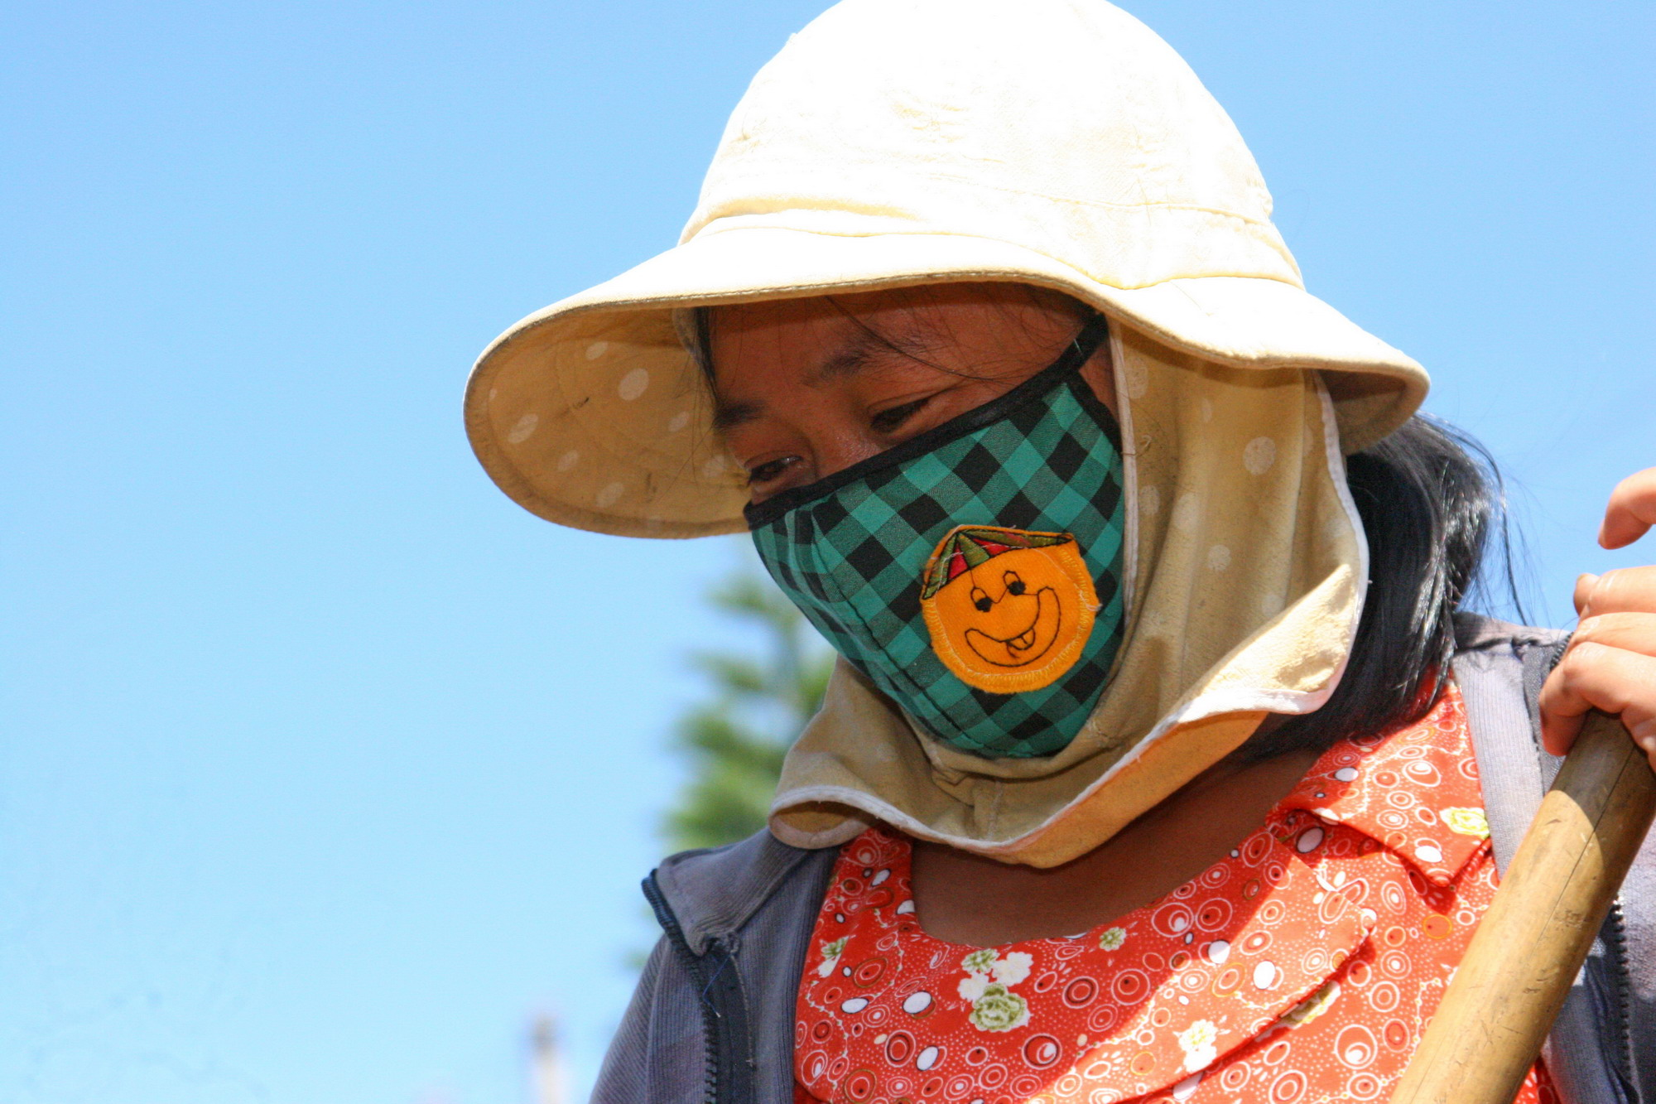

Dalat thai hoa
Notes:
Dalat Thai Hoa. Tran Duc Tai

Slide 3
Leverage the annual budget for sustainability
2 %
of green
coffee value
$350M
*

Slide 4

An aligned coffee sector working towards Key sdgs
Notes:
“we will come back to the SDGs in a second”

Slide 5

A COORDINATED farmer-centric approach
Local/regional coffee sector stakeholders:
Farmers, Farmer Organizations, Traders, NGOs, local banks, extension services
Vision & strategy
Governments of
producing
and consuming countries
Share & learn
Joint action
International coffee sector stakeholders:
Roasters, retailers, traders, standards, NGOs, research

Slide 6
Tools for an enabling environment
Global Progress Framework To measure and report on individual and collective impact
Baseline Common Code A global reference for basic sustainability practices
GCP Connect An online learning community connecting people, resources and action!

Slide 7

Collective action at a Global level!
    Climate Smart Agriculture
    Economic Viability of Coffee Farming
    Gender
    & Youth

Slide 8
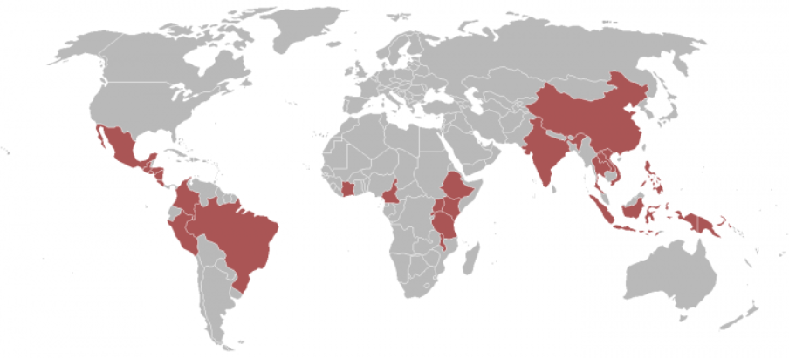
local stakeholders determining their futures
Vietnam
What do you think is a priority for the Vietnamese coffee sector?
Honduras & Peru
Climate smart agriculture strategies
Uganda
Increasing income from coffee for small holder farmers
Brazil
Enabling access to
Brazilian resources for coffee farmer support
Colombia
More efficient cooperation for extension delivery
Indonesia
Increasing income from coffee for small holder farmers
Tanzania
Increasing income from coffee for small holder farmers

Slide 9
GCP supported 2017 Activities in viet nam
Cooperation with & strengthening of the Vietnam Coffee Coordination Board (VCCB)
National Sustainability Curriculum revision & roll-out
Proper Agrochemicals use
Pilot water monitoring system
GCP member engagement & servicing

Slide 10
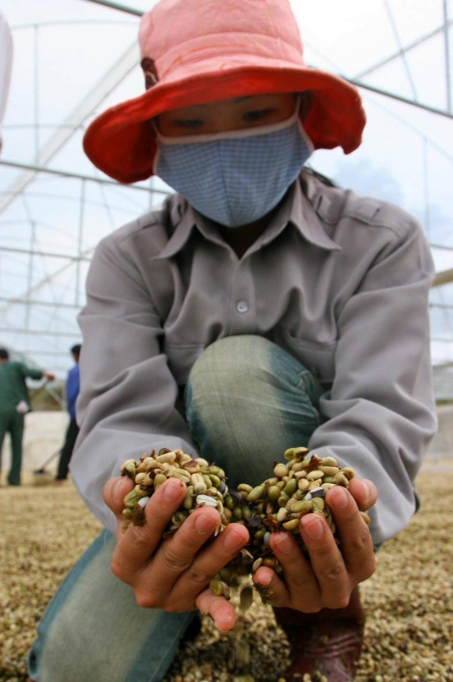
become a member and work with us towards a thriving and sustainable coffee sector.

Slide 11
Trân trọng!
info@globalcoffeeplatform.org

