Slide 1
Achieving impact at scale through collective action in the coffee sector
Let’s ensure profitable and resilient coffee farming communities, together!
Vietnamese Coffee Coordination Board – Forum| 5th December, 2016
Annette Pensel | Executive Director

Slide 2
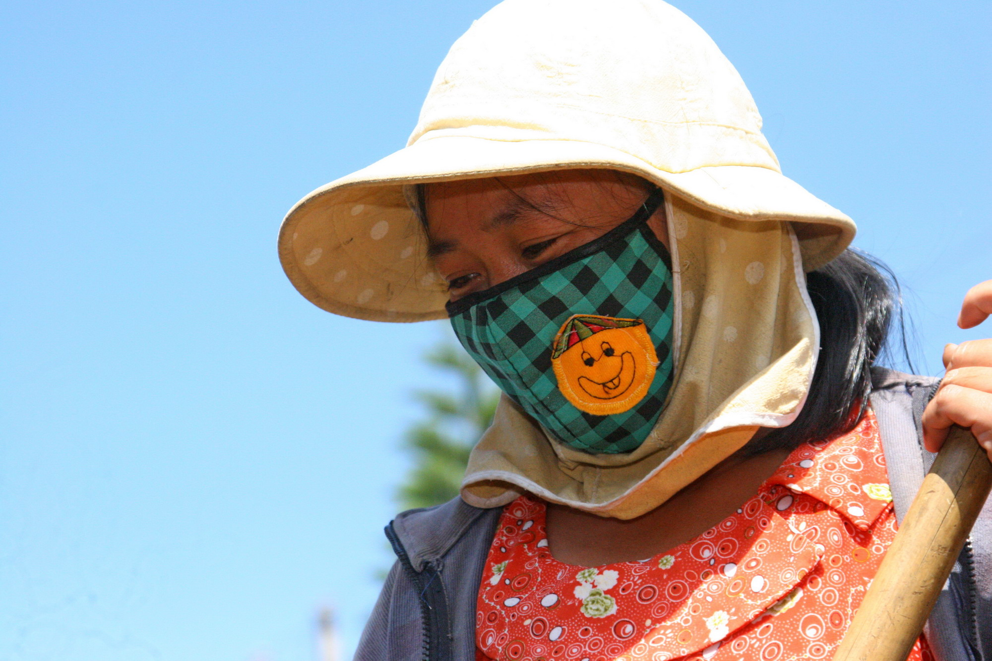

Dalat thai hoa
Notes:
Dalat Thai Hoa. Tran Duc Tai

Slide 3
Progress towards sustainability but systemic challenges REmain
Market
Economic
Environment
Aging farmer population
Labor issues , gender inequality
Poor access to social infrastructure
Consumption growth will outpace production
Consolidation of industry
Price volatility
Inefficiencies
Lack of business case, low wages & low level of organization
Poor access to supply chain infrastructures
Access to finance
Climate change causes loss of production
Soil erosion
Increasing pressure on water, biodiversity and forests
Social
NEED FOR A NEW ERA IN COFFEE SUSTAINABILITY!

Slide 4
Progress but also Fragmentation, overlap & limited impact
Decent work
Gender
Productivity
Finance
Water
Climate Change

Slide 5

An aligned coffee sector working towards Key sdgs
Notes:
“we will come back to the SDGs in a second”

Slide 6
Leverage the annual budget for sustainability
2 %
of green
coffee value
$350M
*

Slide 7
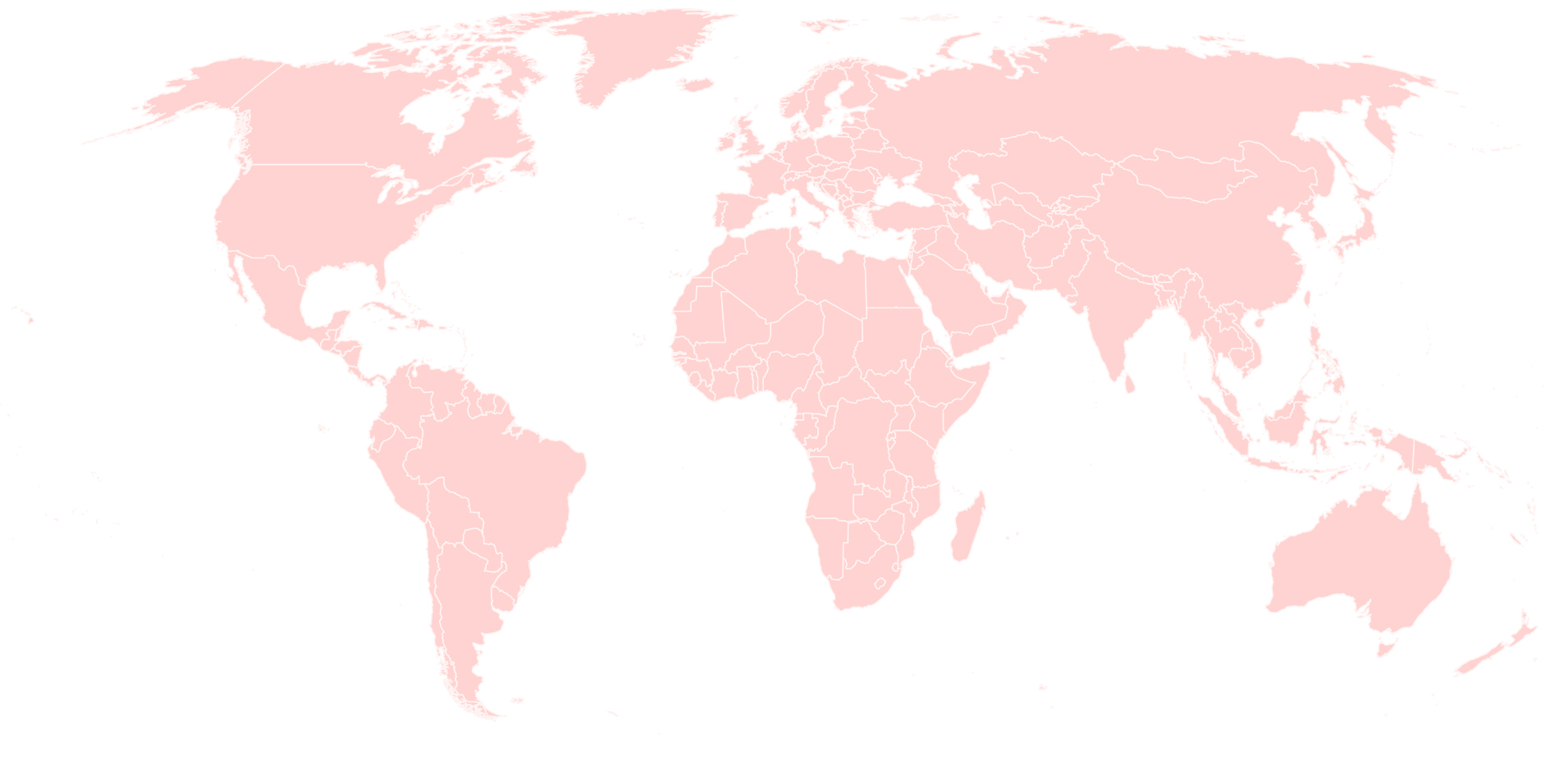
NETWORK WITH 300+ MEMBERS AROUND THE WORLD
Producers
Trade
Industry
Associate members
Civil Society
77
5
3
32
65
3
45
10
5
51
2
6
Notes:
Vietnamese members include Simexco, Dakman, Intimex, Timexcorp
International companies very active in Vietnam: Olam, ECOM , LDC

Slide 8

A COORDINATED farmer-centric approach
Local/regional coffee sector stakeholders:
Farmers, Farmer Organizations, Traders, NGOs, local banks, extension services
Vision & strategy
Governments of
producing
and consuming countries
Share & learn
Joint action
International coffee sector stakeholders:
Roasters, retailers, traders, standards, NGOs, research

Slide 9
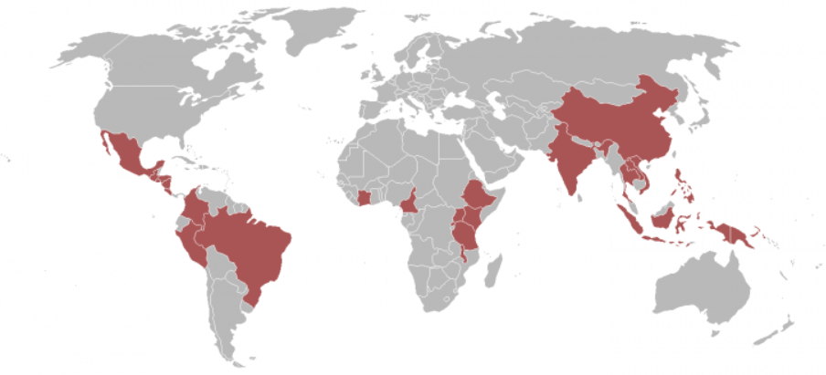
local stakeholders determining their futures
Vietnam
What do you think is a priority for the Vietnamese coffee sector?
Honduras & Peru
Climate smart agriculture strategies
Uganda
Increasing income from coffee for small holder farmers
Brazil
Enabling access to
Brazilian resources for coffee farmer support
Colombia
More efficient cooperation for extension delivery
Indonesia
Increasing income from coffee for small holder farmers
Tanzania
Increasing income from coffee for small holder farmers

Slide 10








The Coffee sector’s contribution to the SDGs

Slide 11











national strategy priorities
No poverty | Zero hunger | Quality education | Clean water & sanitation | Decent work | Responsible Production | Climate Action | Life on land

Slide 12
GCP supported 2017 Activities in viet nam
Cooperation with & strengthening of the Vietnam Coffee Coordination Board (VCCB)
National Sustainability Curriculum revision & roll-out
Proper Agrochemicals use
Pilot water monitoring system
GCP member engagement & servicing

Slide 13
Tools for an enabling environment
Global Progress Framework To measure and report on individual and collective impact
Baseline Common Code A global reference for basic sustainability practices
GCP Connect An online learning community connecting people, resources and action!

Slide 14

Collective action at a Global level!
    Climate Smart Agriculture
    Economic Viability of Coffee Farming
    Gender
    & Youth

Slide 15
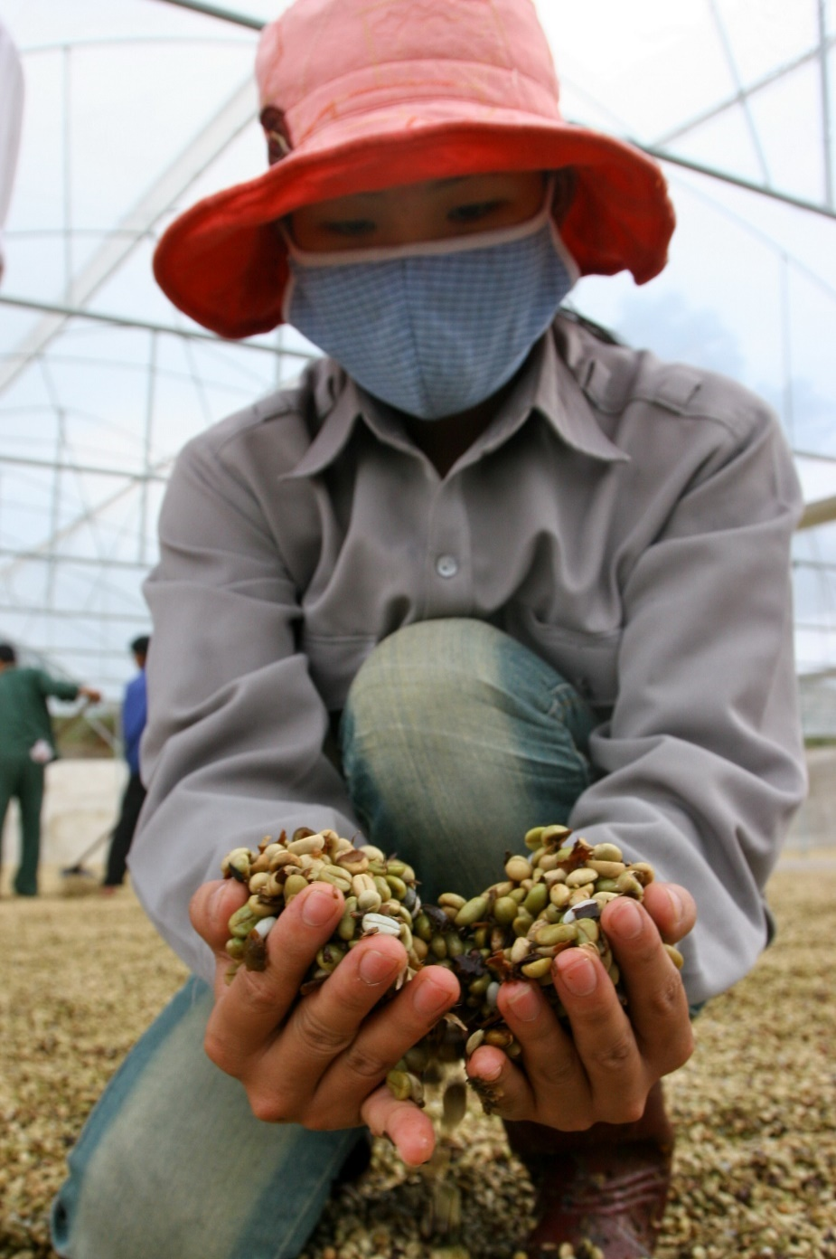
become a member and work with us towards a thriving and sustainable coffee sector.

Slide 16
Trân trọng!
info@globalcoffeeplatform.org

