Slide 1
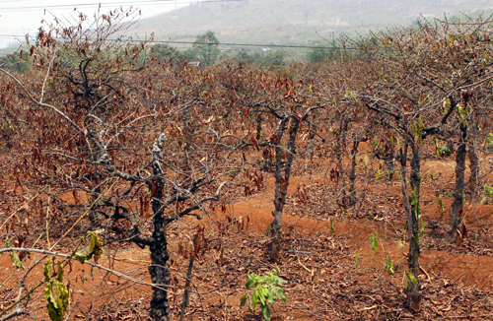
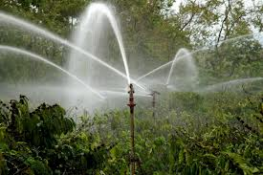
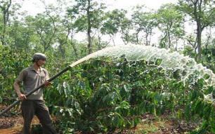
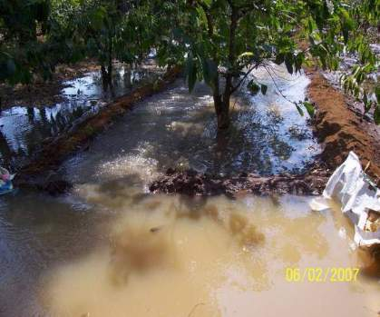
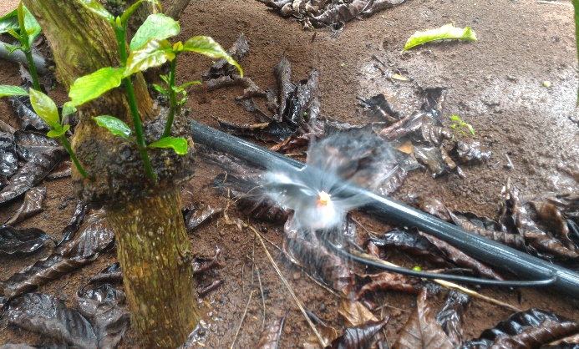
WATER SAVING
COPING WITH WATER SCARCITY UNNDER CHANGING CLIMATE CONDITIONS

Slide 2
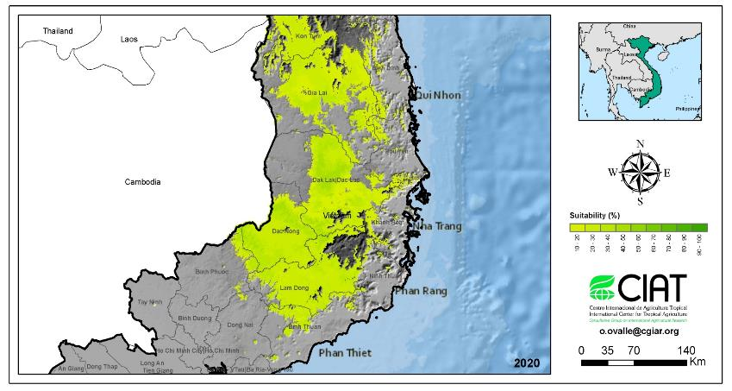
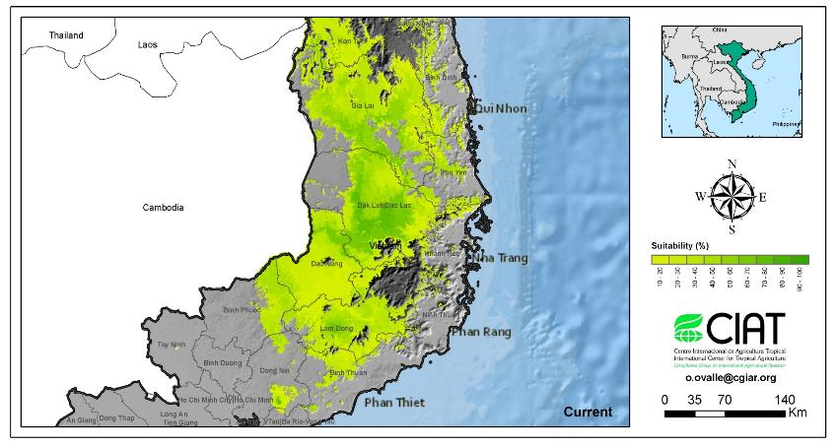
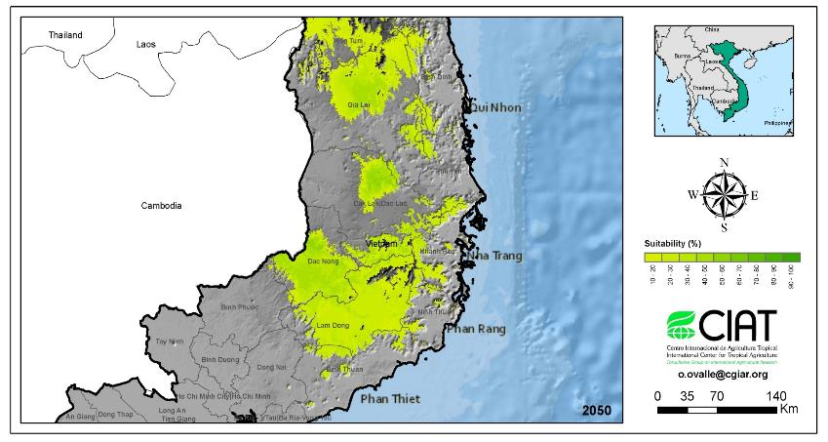
IMPACTS OF CLIMATE CHANGE ON VIETNAM COFFEE PRODUCTION
Changes in coffee production area due to Climate change
(Scenario 2011-2020-2050: due to droughts, production area fall sharply)

Slide 3
WATER SAVING IRRIGATION FOR COFFEE
SUPPORTING SOLUTIONS
Good varieties
Fertilization balance
Efficient pruning methods
Compost
Water saving irrigation
Managing yellow leaf diseases
1
2
3
4
5
6
IRRIGATION SOLUTIONS

Slide 4
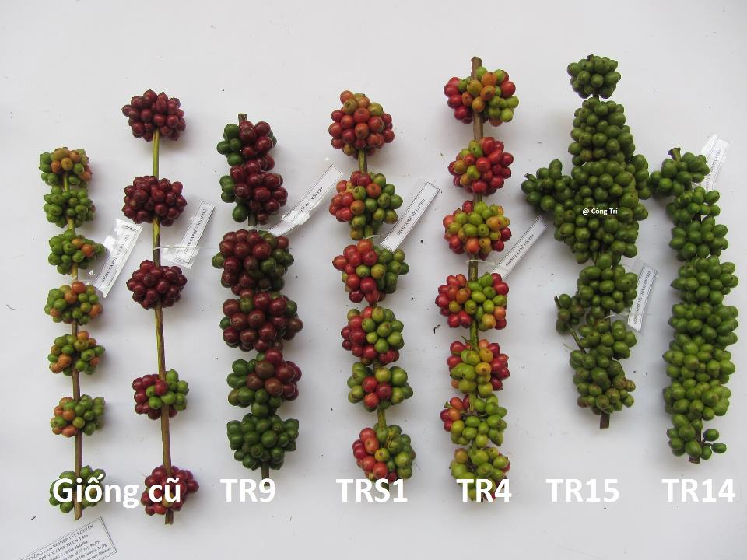
selected by WASI
1. Good varieties
Old varieties
Varieties that are healthy and resistant to drought

Slide 5
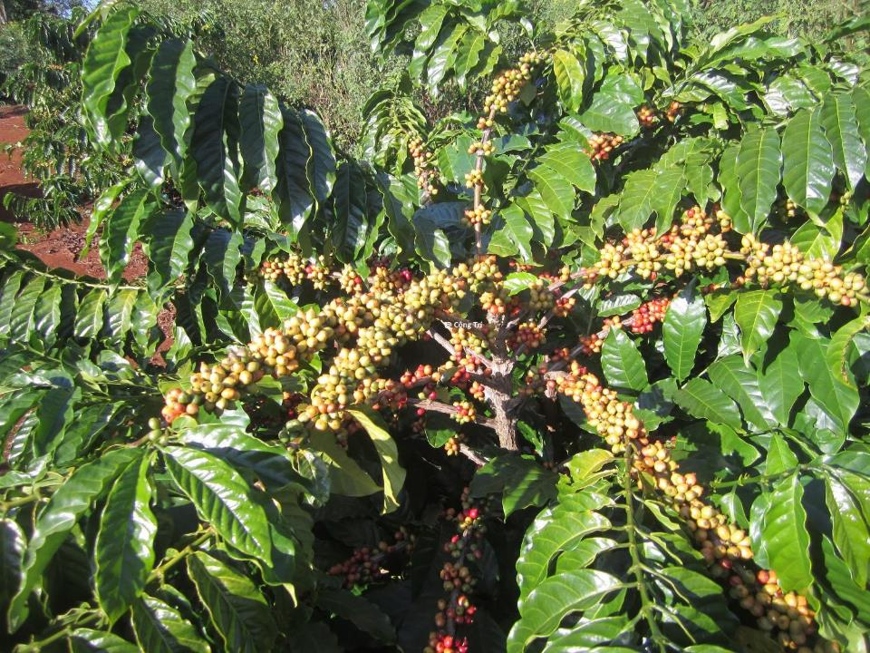
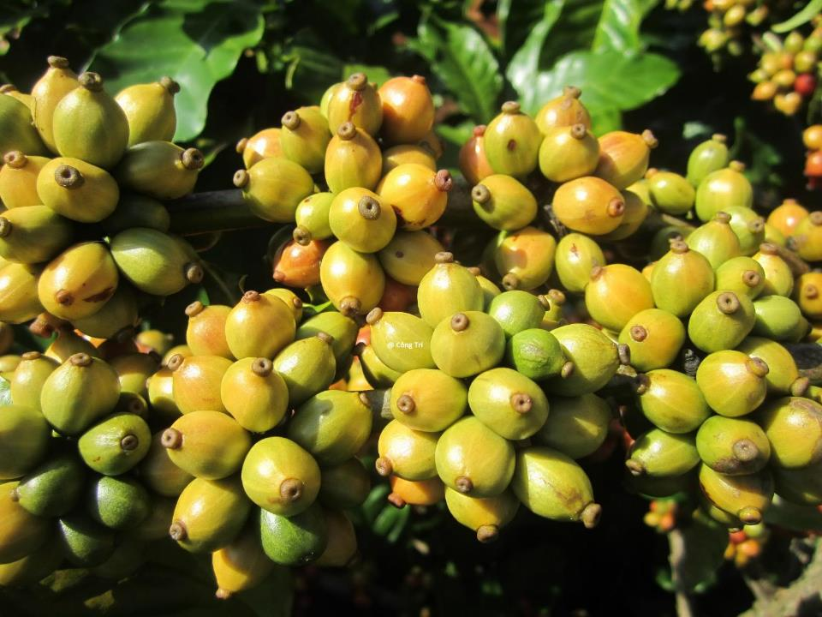
TRS1 – A synthetic hybrid variety
Varieties that are healthy and resistant to drought

Slide 6
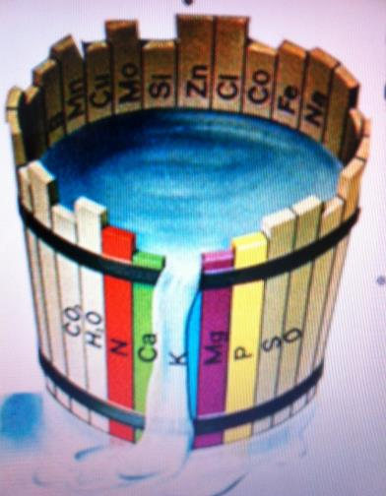
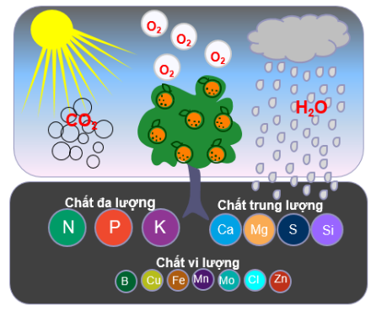
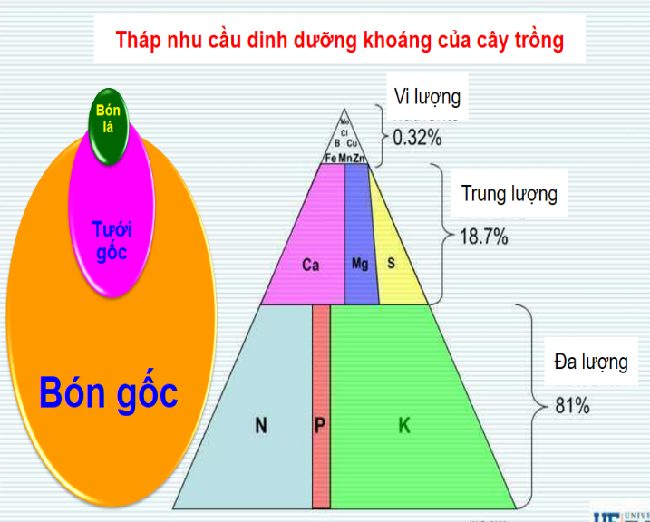
2. Fertilization balance
PLANTS WITH HEALTHY EARLY DEVELOPMENT HAVING STRONG ROOT SYSTEM TO COPE WITH DROUGHT
OVER/UNDER FERTILIZATION POOR PLANT GROWTH & DEVELOPMENT POOR ROOT SYSTEM – LOW RESISTENCE TO DROUGHT

Slide 7
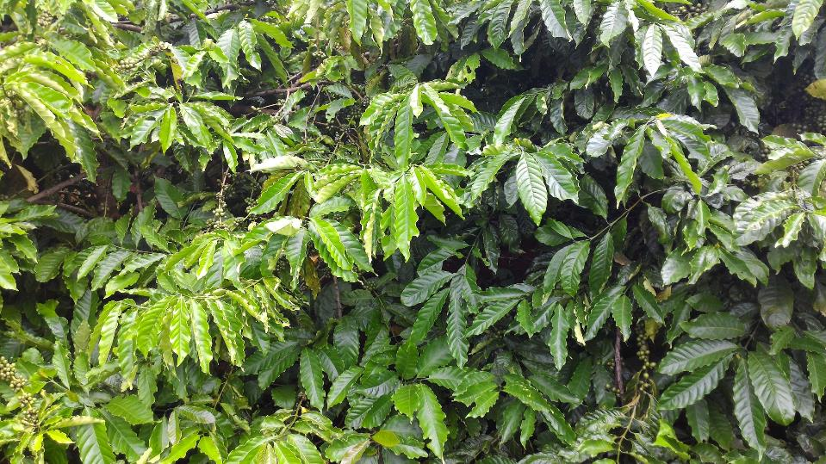
DEMO PLOT ON FERTILIZER APPLICATION
Implemented by: Mr. Công Trí & co-workers (WASI)
Unbalanced fertilization Balanced fertilization

Slide 8
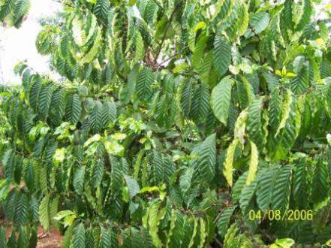
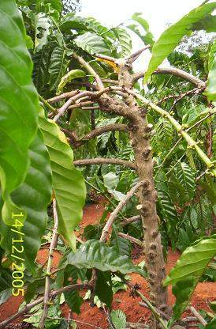
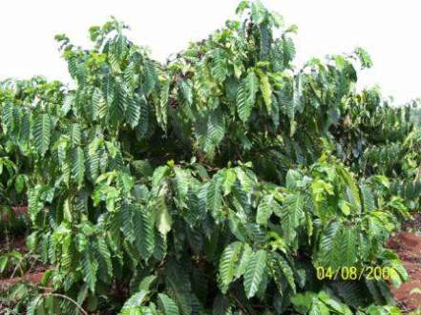
3. Effective pruning
Increasing drought resistance
Proper pruning: even and clear canopy Improper pruning: uneven, missing canopy

Slide 9
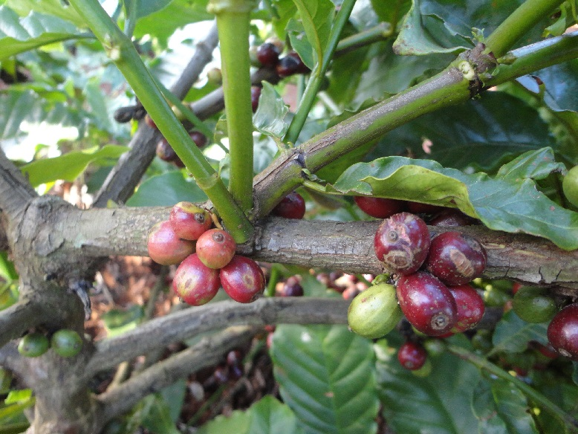
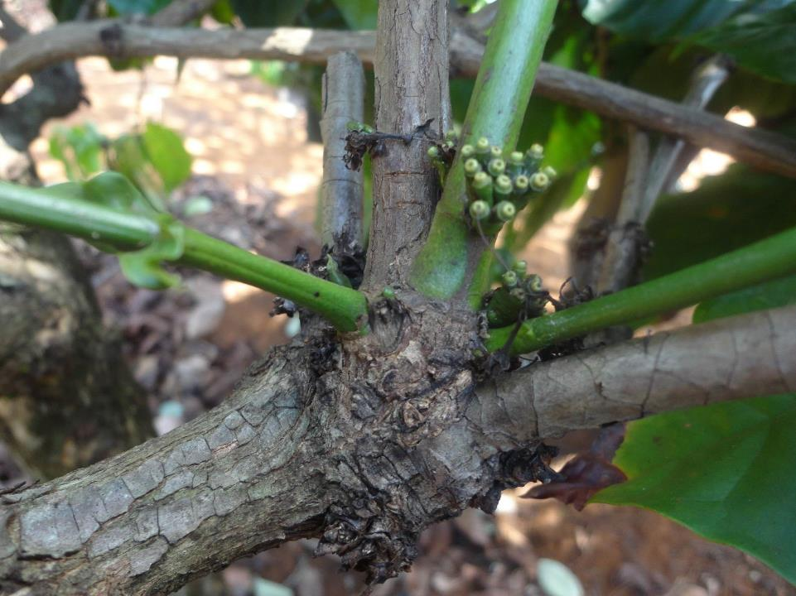
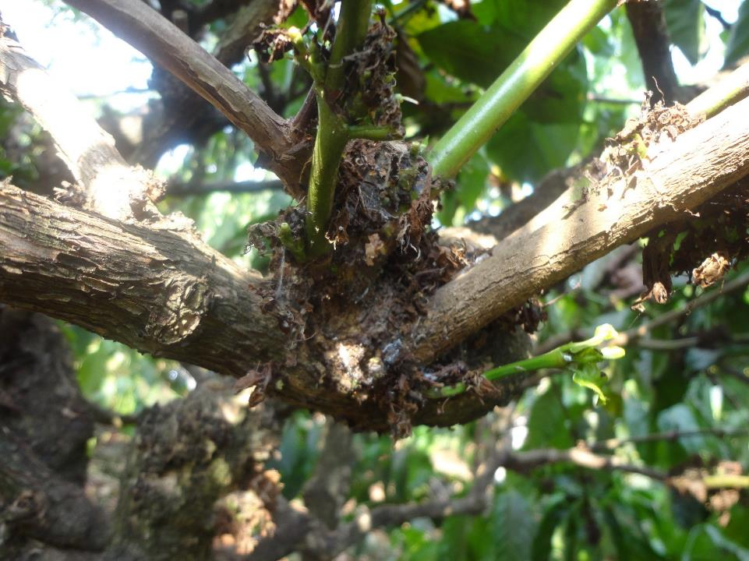
Grafting technique
@ Developed by: Mr. Công Trí (WASI)

Slide 10
4. Managing yellow leaf diseases
Increasing drought resistance
YELLOW LEAF A POPULAR and DANGEROUS DISEASE Various causes of yellow leaf disease in coffee
Soil
Varieties
water
Fertilization
Pesticide
Agent factor
Many
other
causes
AGROCHEMICAL PREVENTION
Not thoroughly and unsustainable
INTEGRATED PREVENTION
Effective and sustainable

Slide 11
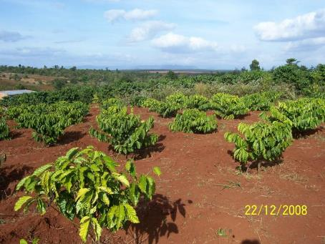
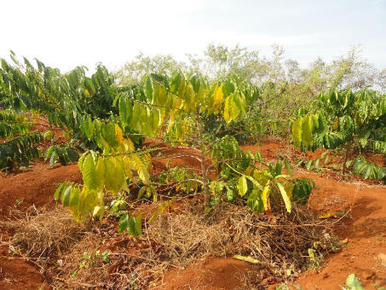
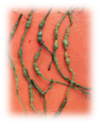
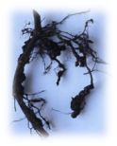
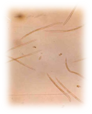
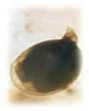
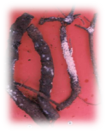
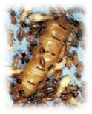
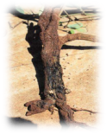
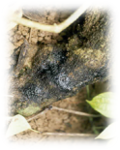
Limps on the root Root rot Male M. incognita Female M. incognita Mealybug Termite Rotten stem and root
Different causes of yellow leaf diseases:
Nematode and fungal superinfection
Root fungi, sore root
Pink disease, rust disease, leaf blight
Root mealy, cicadas
Borer, weevil
Weak root system and nutrition disorders
Organic raw material poisoning, aluminum poisoning
Depending on causes of disease, prevention method will be applied. Paying special attention to ICM

Slide 12
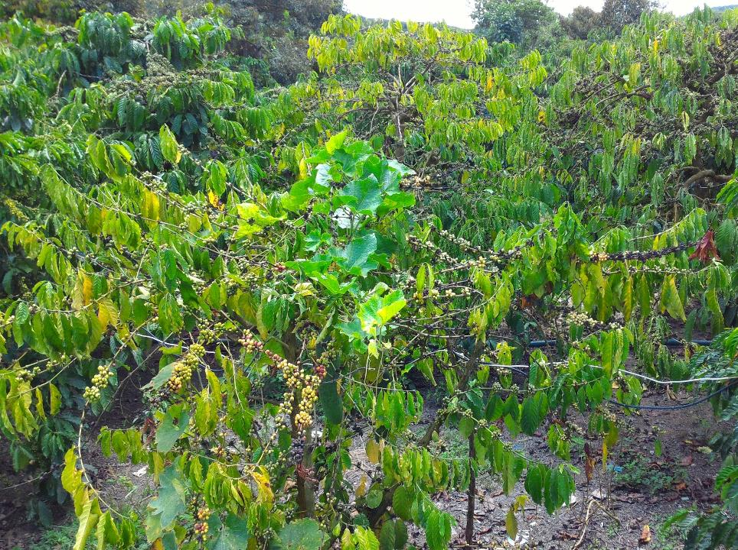
SOLUTIONS TO YELLOW LEAF DISEASE
Step 1: Clean farm, destroy source of disease
Step 2: Lower density of pests with chemicals
Step 3: Biological control, preventing root rot
Step 4: Recovering the root system, improving soil fertility, plant care
During treatment process, foliar fertilizer should be applied to promote growth and recovery

Slide 13
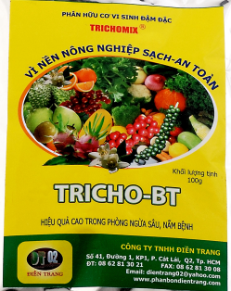
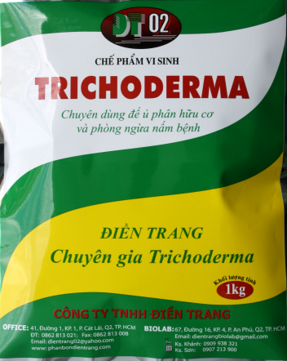
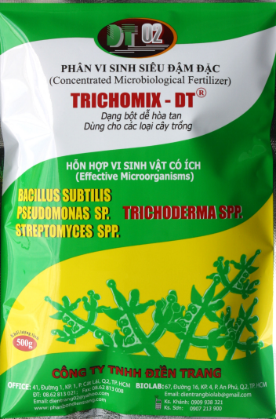
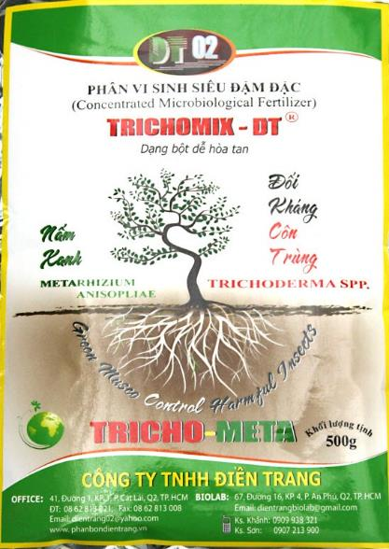
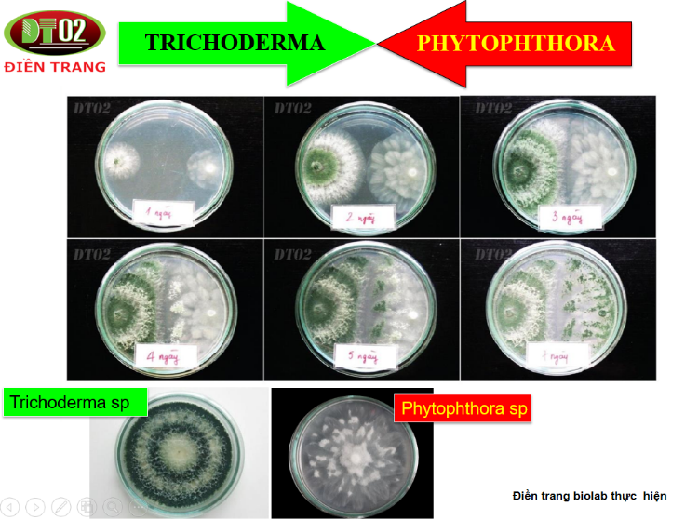
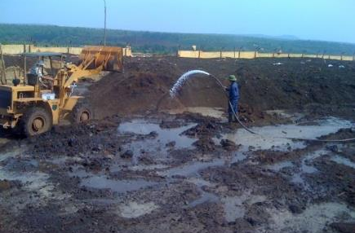
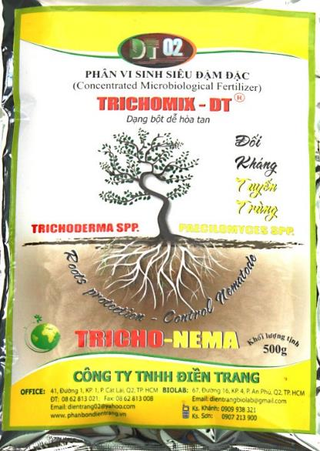
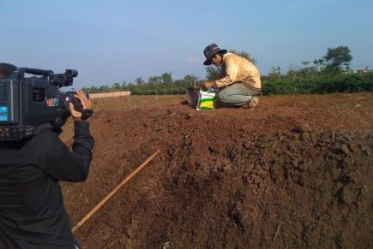
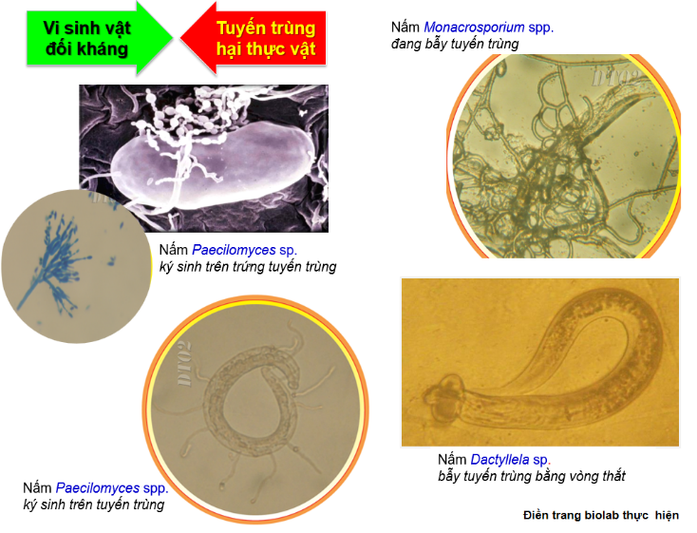
5. Organic and biological solutions
Biological products
- Producing compost from byproducts
- Pest management
Mass production of compost (by company)
Production of compost at household

Slide 14
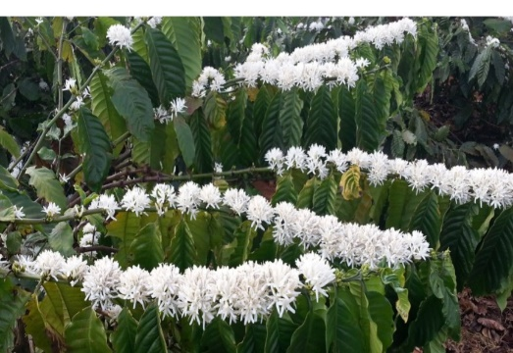
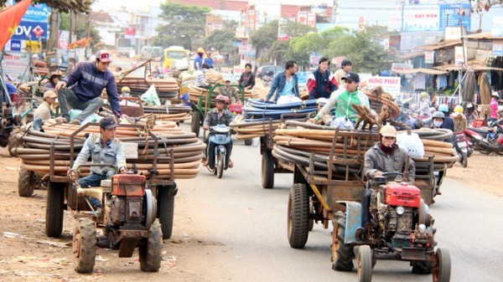
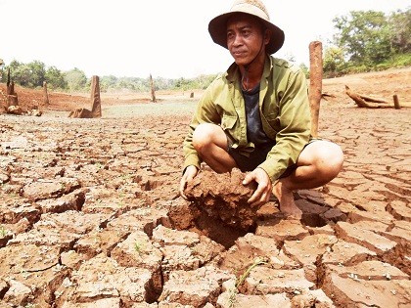
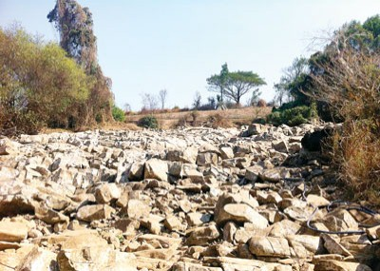
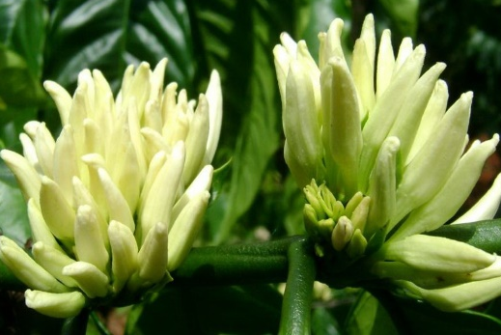
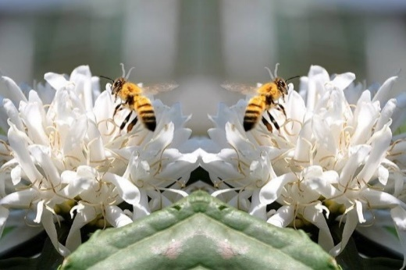
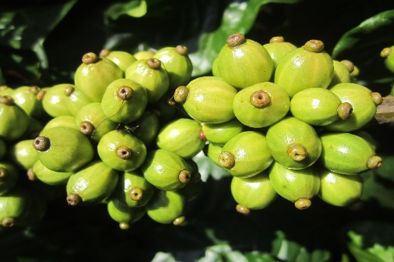
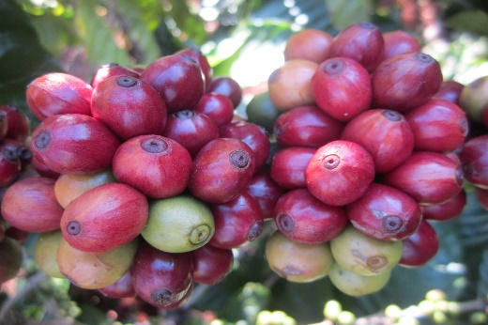
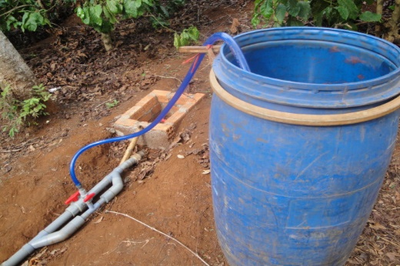
6. Saving irrigation
Solution to drought
Water decides blooming and coffee yield; Rising water demand, depleting water resource
Coffee bloom when receiving Coffee farmers transporting equipment Dry lake with cracked bottom
enough water to water their farm
RESEARCH ON COFFEE: reasonable water application decides blooming, pollination, and fruit set
Water saving irrigation, combining fertilization developed by WASI is a potential effective irrigation solution
New technology, suitable for irrigation need of coffee and pepper, an optimal solution for current conditions of the Central Highlands
Using readily available equipment, low installation cost. long equipment life, easy to operate, convenient

Slide 15
Rising water demand for agriculture, wasteful water use Fertilizer runoff causing water pollution
Water pollution caused by waste Contaminated water source with dead fish

Slide 16
Deforestation, watershed destruction
Degradation and depletion of water resources Well digging to find water source for irrigation

Slide 17
Preservation and rational use of water resource
For sustainable coffee development

Slide 18
VIỆN KHOA HỌC KỸ THUẬT NÔNG LÂM NGHIỆP TÂY NGUYÊN The Western Highlands Agriculture and forestry Scientific Institute (WASI)
Coffee trees
Small pipe
Control valve
Compost pumper
Tertiary pipe
Primary pipe
Secondary pipe
Water source
Compost
Saving irrigation (improved drip irrigation) of WASI

Slide 19
HE Hoang Van Thang, MARD Vice Minister visiting a water saving model
Watering using smaller pipe size
Small sprinkler
Irrigation equipment combining irrigation and fertilization designed and developed by WASI

Slide 20
VIỆN KHOA HỌC KỸ THUẬT NÔNG LÂM NGHIỆP TÂY NGUYÊN The Western Highlands Agriculture and forestry Scientific Institute (WASI)
Saving irrigation
* Advantages:
Saving water, water is applied
directly to the root zone
Enhancing fertilization efficiency
Low installation & operation costs
Weeds and pests are better controlled
Fertilizers can be applied through
irrigation water
* Disadvantages:
- One time investment.
Require design and
installation techniques

Slide 21
THANK YOU FOR YOUR ATTENTION

