Slide 2
Program for today
Thời gian | # | Agenda
13:30 – 13:40 | 1 | Welcome & Opening remarks
13:40 – 13:45 | 2 | Vision 2020
13:45 – 13:55 | 3 | Introduction to the Global Coffee Platform
13:55 – 14:15 | 4 | Vision, Targets, Priorities of Vietnam Coffee Sector by 2020
14:15 – 15:20 | 5 | The sector on the national level, breakout sessions for interactive discussion Round 1: Food safety risks (30 min) Round 2: Environmental risks (30 min) Round 3: Market risks (30 min) Round 4: Others (10 min)
16:00 – 16:55 | 6 | Plenary discussion: presentation of conclusions
16:55 – 17:00 | 7 | Next steps and closing

Slide 3
1. Introduction

Slide 4
The ICO’s mission
Strengthen the global coffee sector and promote its sustainable expansion in a market-based environment.
Practical contributions to the development a sustainable world coffee sector and to reducing poverty in developing countries
Currently the Member Governments represent 98% of world coffee production and 83% of world consumption.
Notes:
The ICO’s mission is to strengthen the global coffee sector and promote its sustainable expansion in a market-based environment for the betterment of all participants in the coffee sector.
It makes a practical contribution to the development of a sustainable world coffee sector and to reducing poverty in developing countries by:
Providing a forum for consultations between governments and the private sector
developing and seeking finance for projects that benefit the world coffee economy
providing objective and comprehensive economic, technical and scientific information on the world coffee sector, and
developing coffee consumption and markets for coffee through innovative market development activities.
The Membership of the ICO stands at 50 and comprises 48 exporting and 8 importing Members. Among the 8 importing Members is the EU.
Currently the Member Governments represent 98% of world coffee production and 83% of world consumption.
In coffee year 2015/16 we had four countries joining the ICO: the Russian Federation, Japan on the importing side; Peru and DRC on the exporting side.

Slide 5
ICO’s Main Activities
Providing a forum for discussion between public and private sector (ICC, WCC, Global Forum, etc.)
Collecting and statistics on the world coffee market (import, export, production, consumption)
Coffee Market Report & economic studies
Coffee development projects
Promoting coffee quality and consumption
Outlook to the future:
ICO undergoes review of strategic objectives to make it fit for future challenges in the coffee sector
ICO will be more effective in addressing emerging challenges such as impact of climate change, ageing trees & farmers, gender and youth inclusion, etc.
Embrace public private partnerships, e.g. through Vision 2020
Notes:
The Secretariat carries out a wide range of activities.
First, we organise various forums and conferences to enable governments and the private sector to exchange views on coffee matters, market conditions and trends, and coordinate policies. At the moment we are preparing the the 117th Session of the International Coffee Council which will take place in September here in London. Earlier this year we were working together with the Ethiopian Government to organise the World Coffee Conference in Addis Ababa. The WCC is the main event for the coffee community and was attended by more than 1,000 delegates from all over the world. It was also an excellent opportunity for Ethiopia to showcase its unique coffee culture.
Besides creating a forum for discussion on coffee matters and policies, the ICO also functions as an information hub. We collect and process data on the world coffee market. As inter-governmental organisation, the ICO is the impartial provider of comprehensive coffee market data. The data is analysed in-house and used to produce various studies, including the monthly coffee market report and other topical studies. The ICO also makes the data publically available, and we are very proud to see it used by policy makers, the coffee industry, and academia.
The ICO also facilitates coffee development projects aiming at fostering economic, social, and environmental sustainability of coffee production. As of today, 38 projects totalling around US$100 million have been funded by the Common Fund for Commodities (CFC), by bilateral and multilateral donor institutions in the form of co-financing, and by the beneficiary countries in the form of counterpart contributions. On-going projects range from interventions to improve coffee quality to the development of tools to mitigate price risks.
Finally, the ICO also undertakes activities to promote coffee consumption worldwide. At the moment my team is working on the campaign for the International Coffee Day on October 1st. The International Coffee Day was established in 2015 as a celebration of coffee farmers and coffee culture. I would like to you encourage you to have a look the dedicated website (www.intercnationalcoffeeday.org). On this website companies and organisations worldwide – including in Indonesia, of course - can submit information related to their campaigns and events to celebrate International Coffee Day.
Let me now give you an outlook to the future of the Organization.
We are currently in the midst of a very important process, the review of the strategic objectives of the ICO. At its 115th Session in Milan, Italy, the International Coffee Council adopted a resolution which calls for a Strategic Review of the activities undertaken by the International Coffee Organization. The process is overseen by the Working Group on the Strategic Review which consists of Members of the ICO.
The purpose of the Strategic Review is to assess, in close consultation with Members of the Working Group, other Members of the Council and the ICO Secretariat, the strategic focus and priorities of the Organization and their implementation, in order propose a new and clearer strategic focus for the Organization with a revised set of strategic priorities and appropriate planned actions. The outcomes of the Strategic Review will be presented at the International Coffee Council in September 2016.
It is anticipated that the ICO will emerge from this process in a way that allows it to effectively address the challenges arising in the coffee sector in the coming years. These challenges include the impact of climate change, the problem of ageing trees & farmers, and the gender and youth gap. These challenges are a threat to the sustainability of the coffee sector in the years to come.
We need to work together to foster a coffee sector which is environmentally sustainable, allows a fair remuneration of farmers, and guarantees a supply of high quality coffee for consumers. The ICO recognises the potential of public private partnerships in working towards this goal. Hence, we increasingly collaborate within the framework of public private partnerships such as Vision 2020.

Slide 6
2. Vision 2020

Slide 7
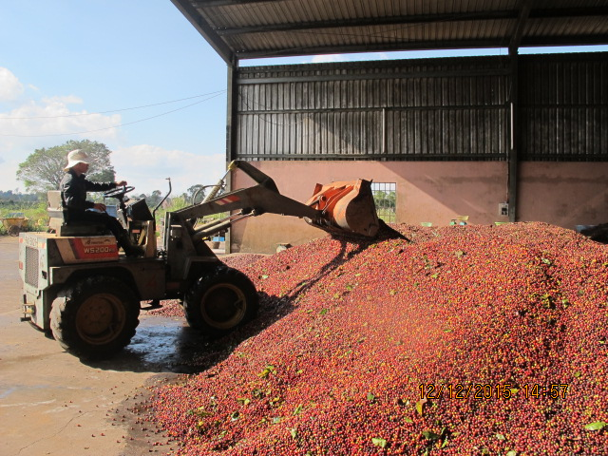
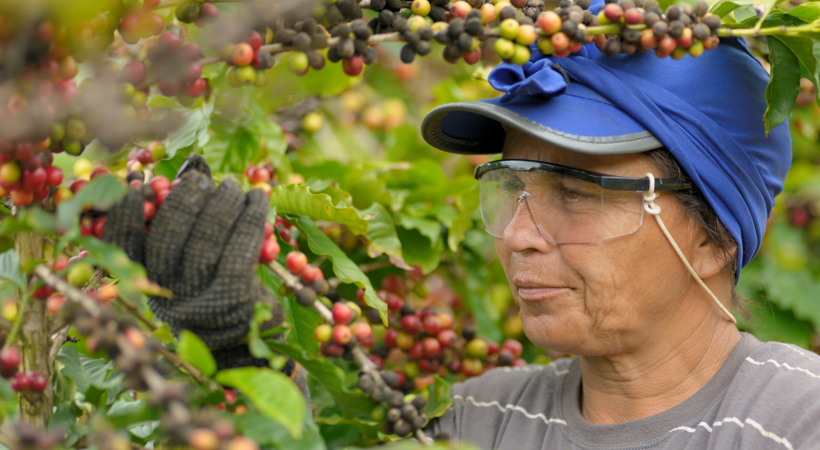
Become one of the leading countries for producing high quality and high value Robusta coffee
One shared goal

Slide 8
Aligned action for collective impact at farm level
Issues in the coffee sector
Our proposal to tackle these issues
An inclusive global network with a joint sustainability agenda
Improved coordination, avoid duplication, enable collaboration…
… increased impact and cost reduction.
Low level of organization
Low productivity
Low wages, child labor
Gender inequality
Climate change
Ecosystem degradation

Slide 9
Key principle guiding the Vision 2020 agenda
Farmer-centric approach that allows to scale-up and create economies of scale
Alignment of fragmented projects into a holistic approach for sector impact
Farmer-centric
Agenda identification on systemic issues
Members integrate the vision into their own visions, goals and activities, and report on progress
Alignment and collaboration through non-competitive actions for mutual benefit
Commitment to transformation
Non-competitive collaboration
Multiple initiatives and perspectives integrated into the vision
An agenda based on market needs
Multi-stakeholder movement
Based on market principles

Slide 10
Vision 2020: A collaborative approach
Collective aim
We aim to create impact on:
Improved livelihoods
Resilient production ecosystems
Profitable farming communities and sector at large
Areas of collaboration
By aligning public and private actors behind:
One sector vision
Thematic workstreams
National agendas
Global Progress Framework
Better aligned interventions & investments
Increasing collective impact
in close collaboration with others
Public-private coordination to
overcome fragmentation
Private sector
Public sector
10

Slide 11
Creating collective impact at farm-level
One vision
& global
work-streams
Reporting & learning
Global
progress
framework
National agendas, national PPP and thematic work-streams
Farmer resilience and livelihood
Implementation
through programs

Slide 12
Bringing Vision 2020 to life: Work-plan until October 2016
Nov – June
Initiative mapping
September
Vision 2020 international workshop in London
April - September
Sector collaboration
in workstreams
September onwards
Develop Vision 2030 and
Global Progress Framework
in line with SDGs
8 March 2016
World Coffee Conference
Launch of GCP
June – August
Consultation with stakeholders through national platforms,
Refining of Vision 2020 goals and concept
October
GCP Membership Assembly

Slide 13
How to Contribute?
Connect@vision2020.coffee
More information
www.vision2020.coffee

