Slide 1
Investment in reforestation to protect the environment, develop landscape, manage forest protection, plant Ngọc Linh Ginseng and other medicinal plants under the forest canopy

Slide 2
1. Current forest condition in Dak Lak 2. Project summary 3. Project targets 4. Forest protection plan 5. Benefits of project 6. Scalability 7. Need of support from ISLA/IDH

Slide 3
1. Current forest condition in Dak Lak
By 2007 total forest area: 580,402.9 ha
By 2014 total forest area: 528,147.0 ha
Over 08 years, total forest coverage reduced by 52,255.9 ha equivalent to 4,0% forest coverage.
Deforestation, degraded forest
Forest cover lost, soil erosion => Droughts, water scarcity
Climate change: total annual rainfall in the Central Highlands is equivalent to 50-60% of the previous years
Hot weather decreasing ground water and surface water
Illegal encroachment

Slide 4
Rampant encroachment creating bare land and hills

Slide 5
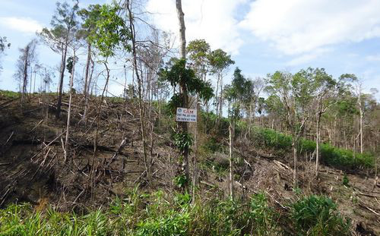
Serious encroachment and burning of forests to clear land for cultivation has quickly turned primeval forests into degraded forests

Slide 6
Eroded forest land, ecological and environmental landscape imbalance

Slide 7
Deforestation becoming increasingly serious due to sabotage loggers
Deforestation in sub-area 300, Đắk Lắk

Slide 9
2. Project summary
No | Land type | Code | Area (ha)
 | Total area |  | 350.00
1 | Agricultural area | NNP | 340.00
1.1 | Agricultural production area | SXN | -
1.2 | Forestry area | LNP | 340.00
1.2.1 | Forest production area (natural) | RSX | 230.00
1.2.2 | Forest production area (replanted) |  | 110.00
2 | Non-agricultural area | PNN | 10.00
2.1 | Road |  | 10.00

Slide 10
3. Project targets
Reforest bare land areas
Regreening bare land, creating green coverage, increasing forest coverage and conserve ground water
Protect current natural forest area
Maintain natural environment to plant Ngoc Linh ginseng and herb plants under forest area => ecological balance, increasing biodiversity
Invest to improve soil poor in nutrient with compost supporting regreening bare land => creating sustainable environment
Prevent forest fire
Protect forest from encroachment

Slide 11
4. Forest protection plan
Developing dams, embankments to conserve clean water; Preventing ground water drop, protecting the environment, utilizing for forest fire prevention and suppression.
Investment in reforestation, regreening bare land, restoring devastated areas
Forest fire prevention: establish forest fire prevention, clean up fire belts, procurement of protection equipment and fire prevention tool
Regular monitoring (protection group, monitoring camera...)
Coordinate with local authority to prevent violations of Regulations on protection and development
Communication, raising awareness of the people to protect forest

Slide 12
5. Benefits of project
Prioritize forest protection, landscape protection. (Forest fire prevention and suppression, ecological balance...)
Regreen bare land area, increase forest coverage, prevent erosion, conserve ground water
Contribute to decreasing encroachment devastating the environment
Develop regional economy, improve people’s living standards, transfer technology on planting herbal plants under the forest area => raising people’s awareness on forest protection.
Provide supply of precious herbs for health care need

Slide 13
Kỳ Nam Việt: Forest environment protection
Solutions of Kỳ Nam Việt to protect forest environment and ground water resource:
Expand replanting area on bare hills in the project (caused by encroachment)
Weeding and thinning => Prevent forest fire
Develop dams and embankments to conserve water; preserve clean water resources; prevent ground water drop; Utilize for irrigation, forest fire protection and suppression.

Slide 14
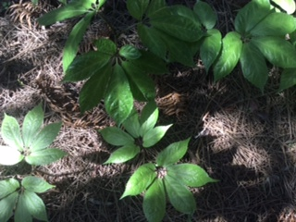
Protect and develop Ngọc Linh ginseng under forest canopy – the most precious herb in Vietnam
Protect forest, maintain stable natural forest environment to raise Ngọc Linh ginseng and other medicinal herbs under forest canopy
Forest protection and Ngọc Linh ginseng protection are our 02 parallel priorities

Slide 15
Without forest - Ngọc Linh ginseng cannot survive

Slide 18
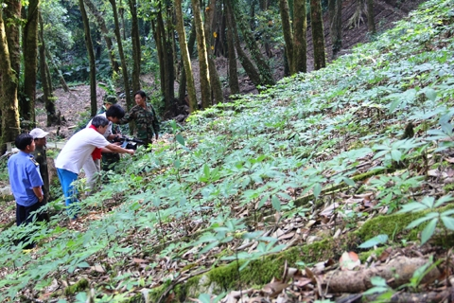
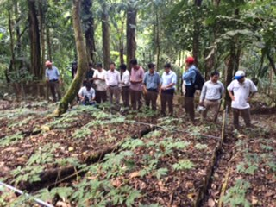
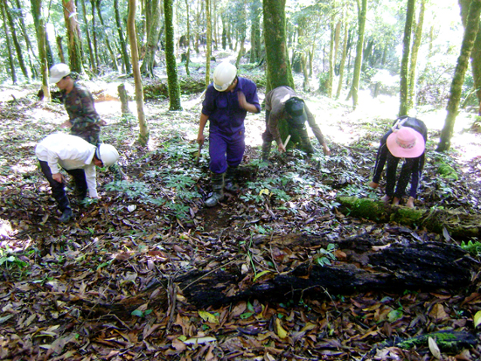

Slide 19
6. Scalability
Transferability
Pilot in a small scale area to select appropriate trees for each area and scale up
Mainly utilize local resources
Handover techniques and training local people on planting and nurturing herbs and Ngoc Linh ginseng
Product consumption
Huge local and global demand for health care

Slide 20
7. Need of support from ISLA/IDH
Challenges in Daklak include deforestation and forest degradation, erosion and soil degradation, water imbalance adversely affecting humans and the environment
Project targets are to ensure health care, better management and protection of natural forest, afforestation of bare land areas
Regional economic development, enhance people’s living standards and people’s awareness on forest protection

Slide 21
Use of loans in environmental protection and landscape protection
Regreening bare land with fruit trees and herb trees
Investment in soil improvement with compost
Forest fire prevention , suppression and detection systems
Developing water harvesting system to prevent droughts and conserve groundwater
Installing monitoring camera system to prevent encroachment and forest fire
Forest management and monitoring

Slide 22
Developing water harvesting system to prevent droughts and conserve groundwater

Slide 23
Dams and water reservoirs in the project provide irrigation water, avoid groundwater drop which is a serious issue today in Dak Lak and help protect the area’s landscape and environment

Slide 25
And used for forest fire prevention and suppression

Slide 27
Many thanks for your attention

