Slide 1
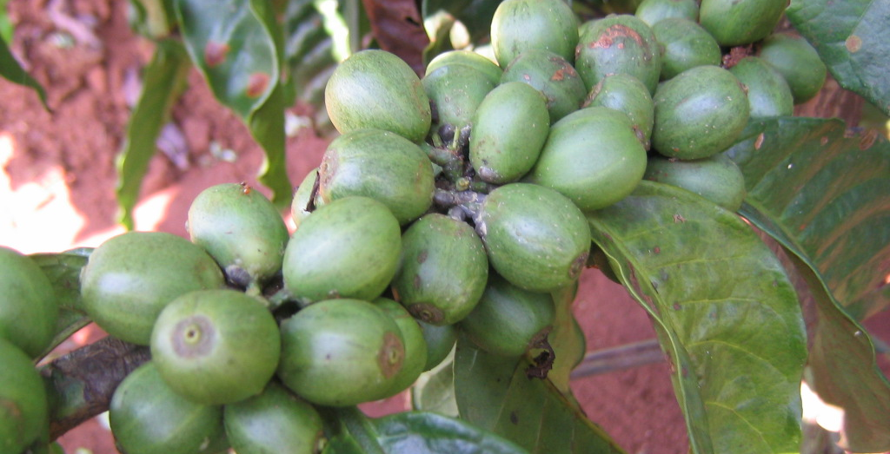
Improving Climate Change Resilience of Coffee Production in Daklak Province - Vietnam
Project Approval _July 2016
Olam International Ltd

Slide 2
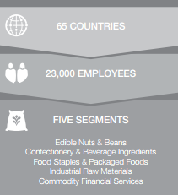
Olam Global Overview

Slide 3
Olam Global Overview
The formative years
Business mode
Development
Rapid Expansion,
Private Equity and IPO
Building a Global Leader
1989 - 1994
1995 - 2001
2002 - 2005
2006- Present
Established to export non-oil products from Nigeria
Exports Cashews from Nigeria, gradually expands into cotton, coco and sheanuts in multiple African origins and India
Engaged in origination, primary processing & trading ? marketing
Shifted HQ to London
Expansion into Asia and Europe
Refined farm gate to factory gate model
Entry into new products e.g. coffee ,rice, sugar & wood products
Incorporated & shifted HQ to Singapore
Developed coherent legal holding structure and appointed global auditor
Private equity investments from Russell AIF, IFC and Temasek
In 2005, listed on SGX at PE multiple of 11x oversubscribed by 15 times
Engaged in origination, primary processing & trading
Built leadership position in edible nuts, sesame, spices and vegetable ingredients, coffee, cocoa, rice and cotton
1st M&A transaction in 2007 (Queensland Cotton)
Expansion into upstream and midstream value chain activities with investments totaling $3.3B during FY2010 – 2012
Investment by Temasek with a 24% stake
Portfolio: 7 products across 4 countries
Portfolio: 10 products across 20 countries
Portfolio: 14 products across 40 countries
Portfolio: 44 products across 65 countries

Slide 4
Olam Global Overview
Middle East &
Central Asia
Europe
Russia
Poland
France
UK
Italy
Holland
Ukraine
Spain
Switzerland
U.A.E
Uzbekistan
Turkey
Uzbekistan
N.America
Asia
USA
Singapore
China
Indonesia
Vietnam
Malaysia
Myanmar
India
PNG
Thailand
Laos
Cambodia
N.Africa
Algeria
Egypt
E.Africa
Tanzania
Uganda
Sudan
Zambia
W. Africa
Central &
South America
Nigeria
Ghana
Togo
Ivory Coast
Cameroon
Gabon
D R Congo
Mali
Congo
Brazil
Costa Rica
Mexico
Panama
Argentina
Peru
Colombia
Honduras
Ecuador
Southern
Africa
Oceania
Australia
Mozambique
Zimbabwe
S. Africa

Slide 5
Olam Vietnam Overview
1997: Rep Office Started
1999: License to establish 100% foreign entity OVL (only for coffee)
2001: Cashew/Pepper with plants in Bien Hoa, Quy Nhon, Gialai, Phu Yen.
2005: Started Timber operations
2008: Instant Coffee Porject in Long An – Vietnam.
2016: Expansion of Instant coffee plant in Long An – Vietnam
Top exporter of cashew
Top exporter of pepper
Top 3 exporter of coffee
+2400 employees

Slide 6
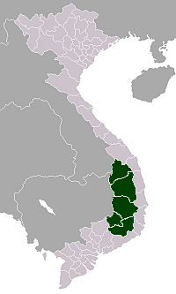
Operational footprint
Olam Vietnam - Coffee
Processing & Storage
Premium/Polish: 7k/1.2k MT p.m.
Wet milling: 5.2k MT cherry p.m.
People
Staff: 217
Casual labor: 300+
RC/PC mix: 85:15
Procurement
LBAs: ~270 in total (45% coverage)
10% LBAs contribute ~60%
IH Storage: 43k MT
Dry Milling: 1.5k MT parch p.m.
4 Branches. 14 Buying Units
CR&S
4C / UTZ / RFA Robusta & Arabica
Arabica HG Farmer Group
Nestle Project. ISLA/Lavazza Project
Cover 87% of Rob & 70% of Ara Prod Areas
Mkt Share ~8%
OP
Pleiku
Input: 2.4k MT p.d.
Throughput: 15k MT p.m.
Operated by Olam
Buon Ma Thout
OP
Operated by third party
213 Local Staff
TP
Daknong
Me Linh
WM
OP
Di Linh
Binh Duong
WH
Dedicated Agronomy Unit
WH
Song May
OP
Own Processing
TP
Toll Processing
WM
Wet Milling
WH
Ware House

Slide 7
Lavazza
Project partner | Luigi Lavazza SPA
Name and location | Lavazza, Italy since 1895
Type of organization | Company
Relevant experience & capacity of the organization | Lavazza is an Italian-based coffee roaster. Their corporate sustainability strategy can influence the situation on the ground. Lavazza has a long track record in investing in promising projects on the ground in a wide-variety of origins and is a member of the Initiative for Coffee & Climate.
Main role and responsibilities in the project | Provider of co-funding, read project progress reports, provide feedback on project progress and outcomes, especially studies into agro-forestry business cases and carbon foot-printing, participate in annual Steering Group meetings to monitor project implementation and budgets, consider project outcomes if and when adjusting company CSR strategy.

Slide 8
Project Summary
General information proposed project
Title of the project | Improving climate change resilience of coffee production in Dak Lak province, Vietnam
Location(s) of the project | Dak Lak province, districts of Cu M’gar, Krong Buk, Buon Ho, Ea H’leo and Buon Ma Thuot
Expected number of beneficiaries (m/f) | 1,245 farmers of which at least 15% are female farm owners.
Expected area covered in ha | 1,160 ha
Project duration | 2.5 years with ISLA. Olam and Lavazza will continue implementation for 2.5 years more.
Proposed starting date | 7/2016
Total budget | 605,405 EUR
Amount requested from ISLA | 200,000 EUR
Amount of co-funding from the private sector: companies active in or sourcing from the area | Olam Vietnam: 135,135 EUR (150,000USD) Lavazza: 270,270 EUR (300,000USD)
Amount of co-funding from other donors | Nil

Slide 9
Project Summary
District | Commune | Expected # of farmers | Total by district
Cu M’gar | Ea Pok Ea Drong | 250 240 | 490
Krong Buk | Cu K’bo | 100 | 100
Buon Ho | Ea Sien Cu Bao | 75 90 | 165
Buon Ma Thuot | Ea Kao, Tan Hoa | 250 120 | 370
Ea H’hleo | Ea Nam | 120 | 120
Total |  |  | 1,245

Slide 10
Project Objectives
Short term objectives (up to 2018): (up to 2018):
Professionalise farm management to safe-guard productivity and farmer income earning capacity
Diversify farming system to reduce farmers’ risk exposure to effects of climate change
Pilot carbon foot-printing in line with coffee PCR and toxic-load tracking based on EIQ of coffee production and processing.
Integrate innovative service delivery to farmers in the Olam commercial operations.
Contribute positively to Vietnam coffee policy debate
Long term objectives (beyond 2018):
Climate-change proof Olam Vietnam coffee supply chains
Map, track and reduce environmental footprint of Olam coffee from Vietnam in line with EU PEF approach

Slide 11
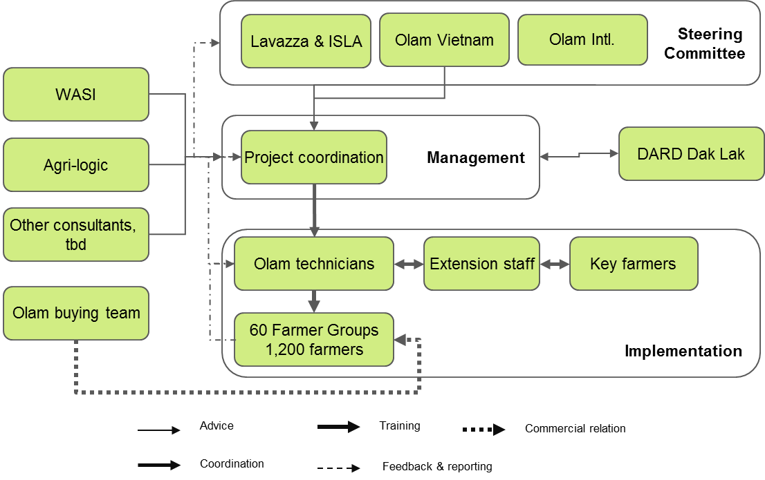
Partnership

Slide 12
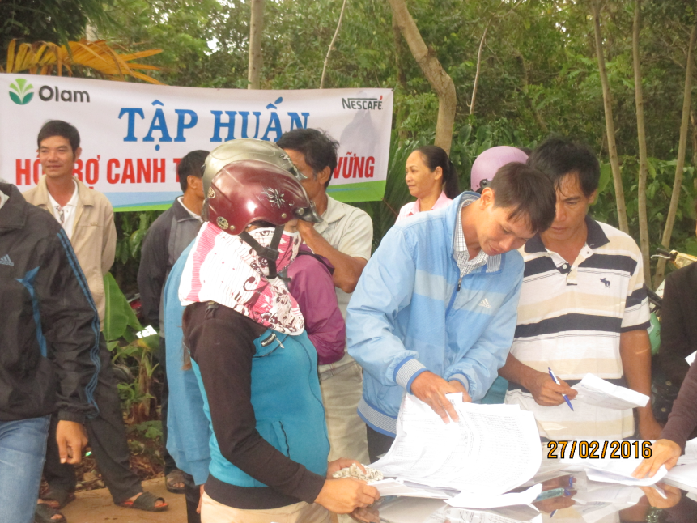
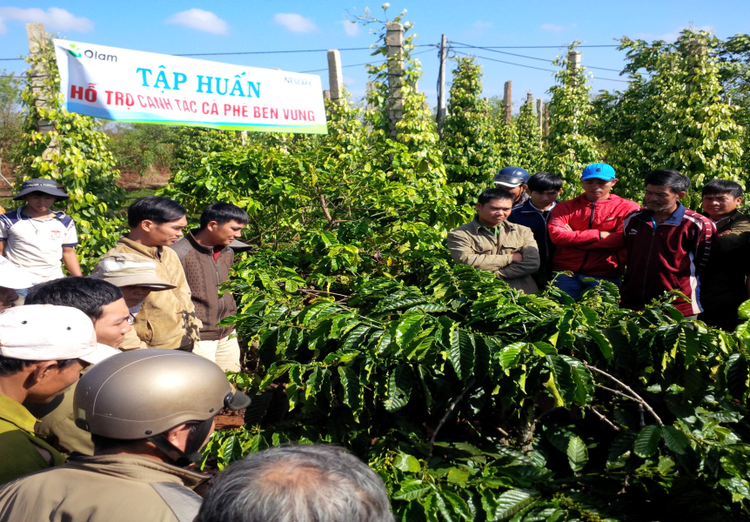
Outcome indicators and targets
 |  | All partners |  |  |  | Lavazza only
KPIs | Output with ISLA time frame | Total target | Target year 1 | Target year 2 | Target year 3 | Target year 4 | Target year 5
Mandatory ISLA indicators (fill in targets only if applicable to intervention area of the project)
# of farmers/workers and community members trained | Output | 1,245 | 1,245 | 1,245 | 1,245 | 1,245 | 1,245
# of trainers and government staff trained through program companies/NGOs to efficiently deliver services | Output | 25 | 25 | 25 | 0 | 25 | 0
# and of physical structures established <specify structures, e.g. fence, dam, warehouse, etc.> | Output (water flow meters for irrigation) | 30 | 30 | 0 | 0 | 0 | 0
Adoption rate by producers/workers/ community members (m/f) trained | Outcome | 70% | 40% | 55% | 70% | 75% | 80%
#has of farmland/ plantation area where trained practices are applied | Outcome | 1,160 | 400 | 750 | 1,160 | 1,160 | 1,160
# of processing facilities with sustainable production practices and social standards applied | Outcome | 4 | 4 | 4 | 4
# of smallholders / community members with formal/informal land title | Outcome | 1000 | 1000 | 1000 | 1000 | 1000 | 1000
# of hectares with land or forest restoration or afforestation | Outcome | 400 | 50 | 100 | 400 | 450 | 500
Project specific indicators (you can list additional indicators that you want to use for your specific project here)
# of farmers with FFB |  | 150 | 150 | 150 | 150 | 150 | 150
# of on-farm irrigation tests |  | 12 | 12 | 12 | 12 | 0 | 0
Production cost reduction against base prices year 0 |  | 0% | 10% | 15% | 20% | 20% | 20%
Income improvement against base prices year 0 |  | 5% | 10% | 15% | 20% | 25% | 25%
Productivity improvement |  | 10% | 0% | 5% | 10% | 15% | 15%
Carbon footprint reduction |  | 20% | 0% | 10% | 20% | 25% | 25%

Slide 13
Exit Strategy
Some services that have a clear and direct benefit to farmers (e.g. soil sampling and fertilizer advice) will be made available at cost. This we will already try out during the project. Once farmers get used to paying for some services we can build on that realization by gradually expanding service packages to perhaps also include FFB analysis for farmers beyond the project duration.be better able to access carbon credit payments, if any
Farming system changes such as new irrigation methods and various types and densities of shading introduced during the project will have long-term sustainability if we can ensure that the changes make sense from a farm economic perspective and provide viable alternatives to managing farms under changing climatic conditions.
As Olam will continue to support the farmers because:
Olam continue the project with Lavazza after the period with ISLA
Buying through groups allows us to access better quality coffee and ensure that premiums, if any, end up with farmers, it also allows us to maintain sustainability certification
Having groups in place allows us to quickly reach a large number of farmers with relevant new training messages if new challenges arise (e.g. new pest outbreaks) which can be beneficial to our supply security

Slide 14
Thank You!

