Slide 1
INITIATIVE FOR SUSTAINABLE LANDSCAPES (ISLA)
Tran Quynh Chi

Slide 2
Program Management

Slide 3
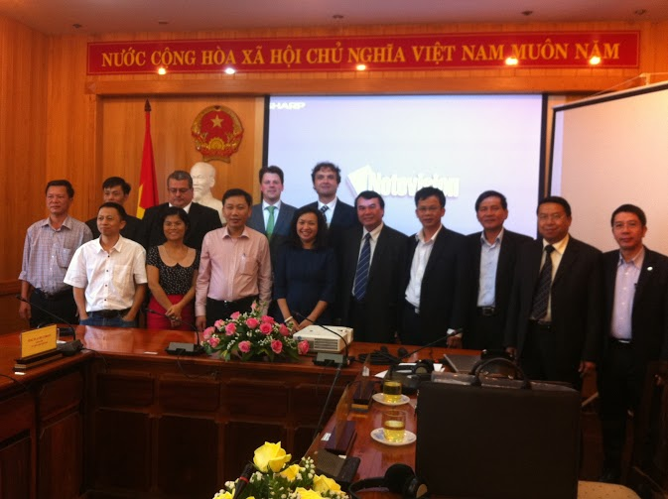
ISLA Lam Dong Steering Committee
Established in 2015
Chairman: PPC Vice Chairman
Membership: 50% public, 50% private
Meeting 2 times/year

Slide 4
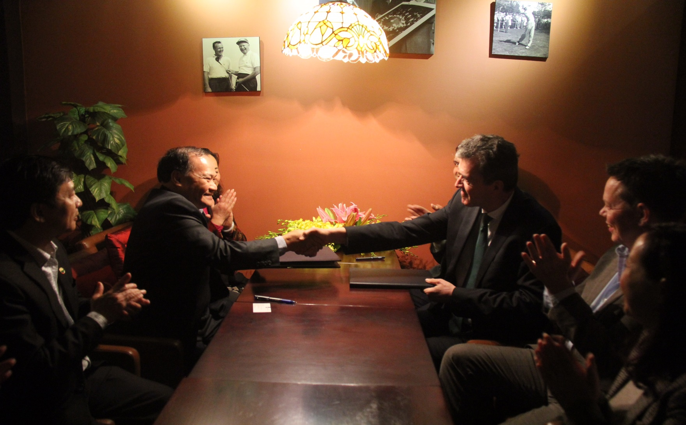
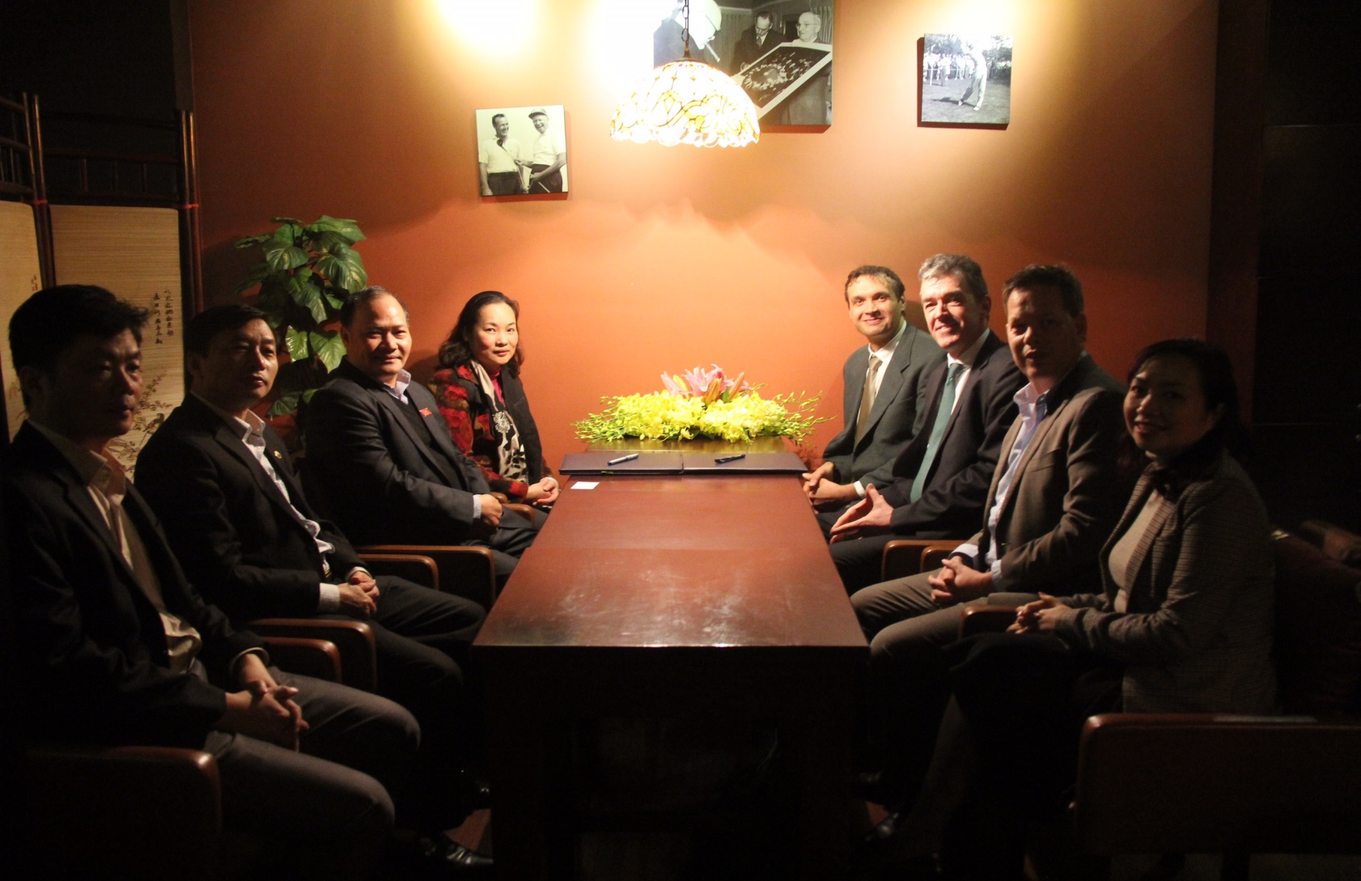
Cooperation Agreement between IDH and Directorate of Water Resources, MARD

Slide 5
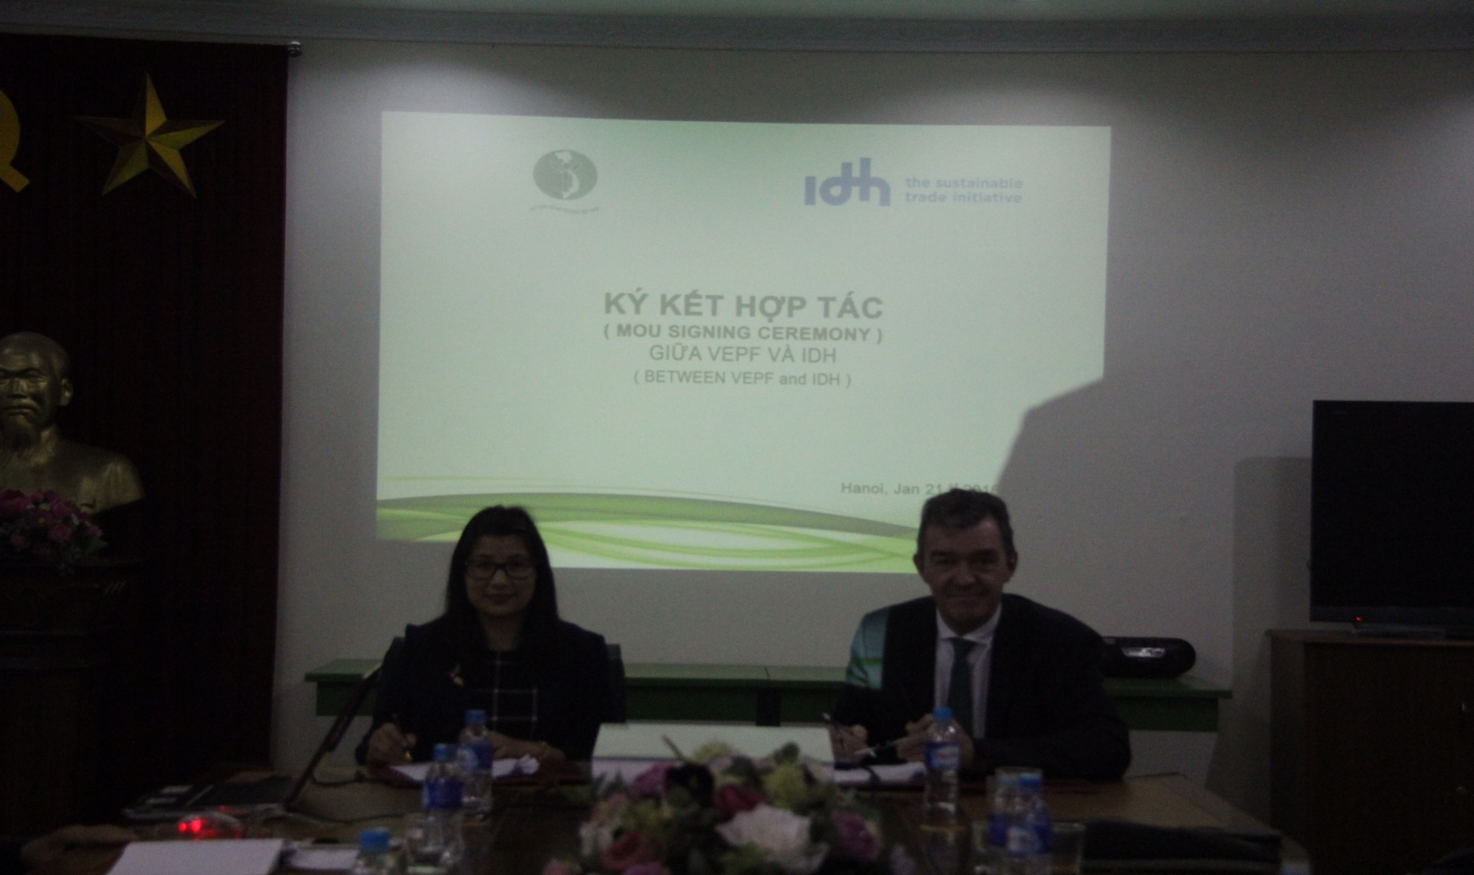
Memorandum of Understanding between IDH and Vietnam Environment Protection Fund

Slide 6
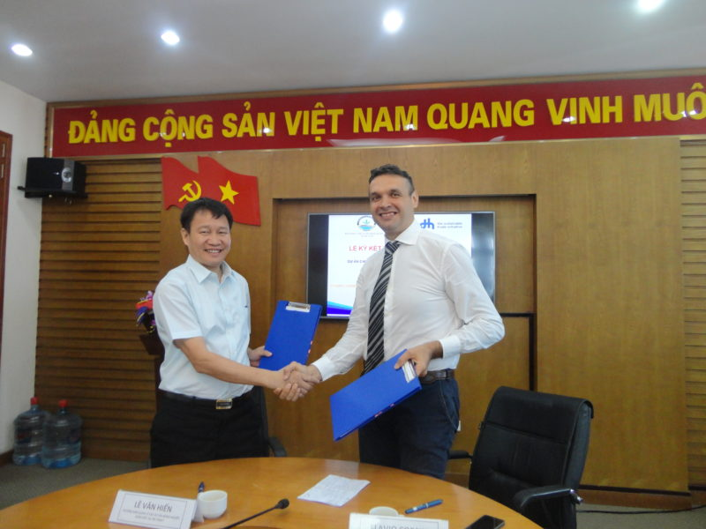
Cooperation Agreement between IDH and VnSAT

Slide 7
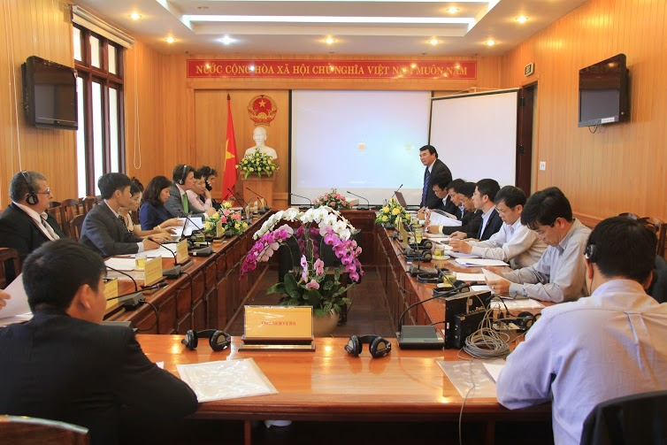
3 meetings of ISLA Lam Dong Steering Commitee

Slide 8
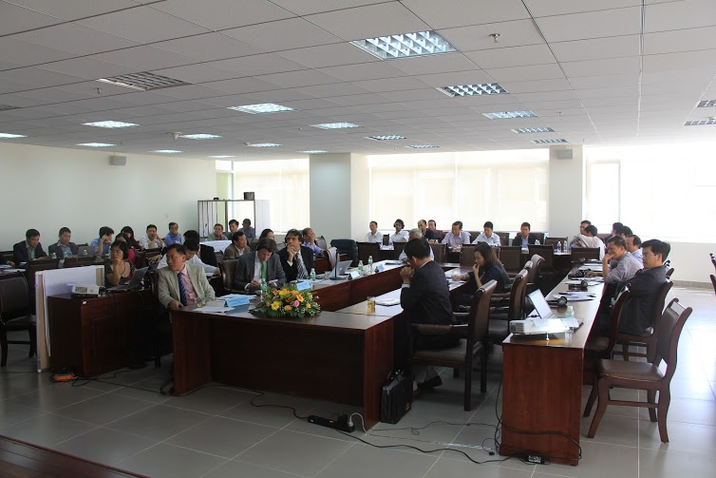
3 meeting with key stakeholders

Slide 9
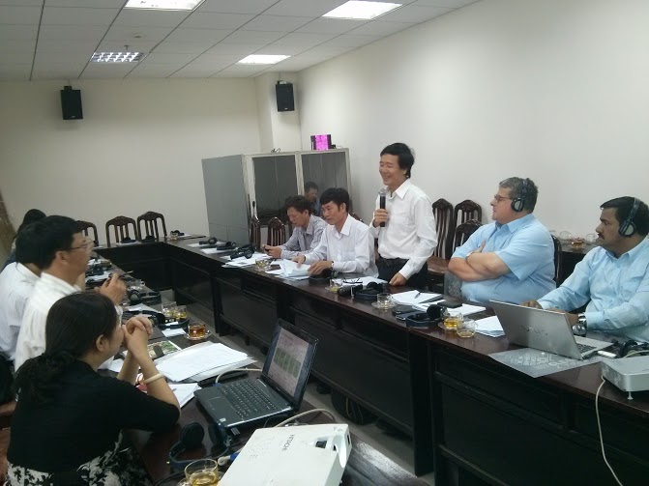
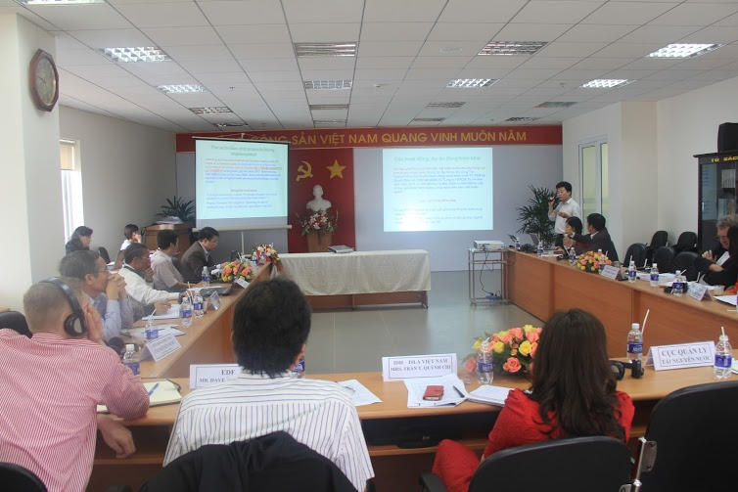
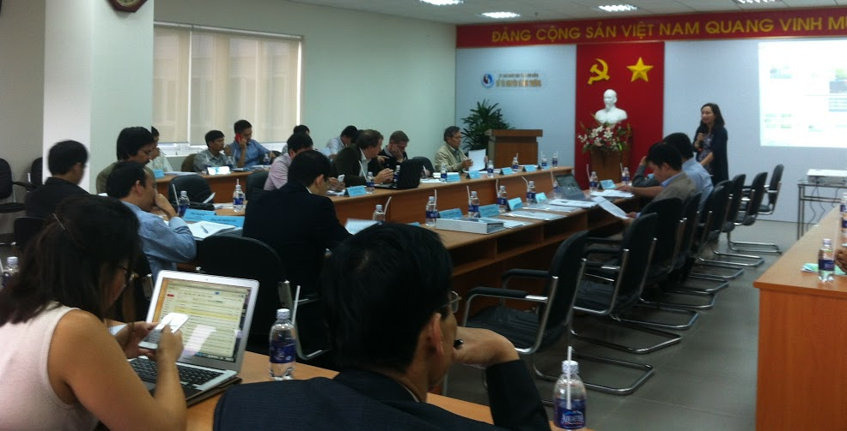
5 expert meetings

Slide 10
Proposal on Daklak Sustainable Landscape Steering Committee
Governance of the Steering Committee:
  Chairman: Daklak PPC Leader
  Public sector: DARD; IPSARD; DPI, Cu Mgar PPC
  Private sector: IDH Vietnam, Jacob Douwe Egberts (JDE), Olam Vietnam, SIMEXCO, ACOM, Ky Nam Viet
Roles and reponsibilities:
  Provide recommendations on policy, agenda, project to develop a vision on sustainable landscape development of the province
  Connect, coordinate, integrate public-private investment to further upscale models
  Develop network among departments, agencies, branches, between public and private sectors.
  Closely coordinate with Central Highlands Steering Committee

Slide 11
Intervention groups

Slide 12







Water management
Data collection
Tool identifying risks associated with water scarcity
Proposing sustainable water resource management in Lam Dong
PPC Dak Lak and Lam Dong
Review on water saving, sustainable water resource management
PPP co-funding in irrigation system
Water pricing
Applying water saving/water harvesting

Slide 13

Agroforestry/reforestation and forest protection
VnSAT
Intercropping with coffee
Landscape planning in coffee production areas
Field level projects
Growing medicinal herbs & coffee under canopy
WASI

Slide 14
Agrochemical Management
Research
Policy & regulation
Business cooperation
Improving management system
Public-private monitoring
Pilot
Tea
Registration
Use control
Vege
Coffee
Use and trade control

Slide 15
Field level projects

Slide 16
Local projects
Selected 8 out of 18 projects to support :
  2 public projects: DARD Lam Dong and DWR
  6 private project: 2 local companies, 4 FDI companies
Sectors/Areas:
  5 coffee sustainable landscape projects
  1 irrigation project for vege
  1 project on medicinal herbs under canopy
  1 landscape planning project in 1 commune
Total budget:
  Total public & private contribution: ~ 5 mill EUR

Slide 17


